Slide 1
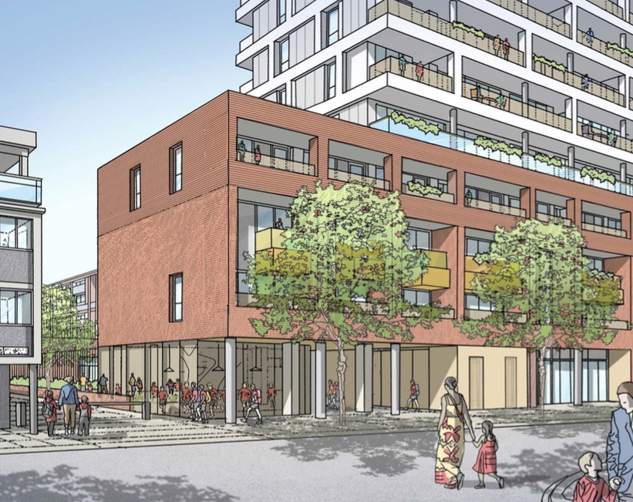
COLPAI Project: Progress Of Works
Online Public Webinar
Thursday 7 July 2022, 7pm

Slide 2
Webinar Protocol
The project team is available to discuss and answer questions regarding progress with the works on-site only
This meeting is not designed or intended to be solely a forum for debating planning related matters, which should be raised with the appropriate planning officers
We request participants be respectful to all attendees so the webinar runs smoothly.

Slide 3
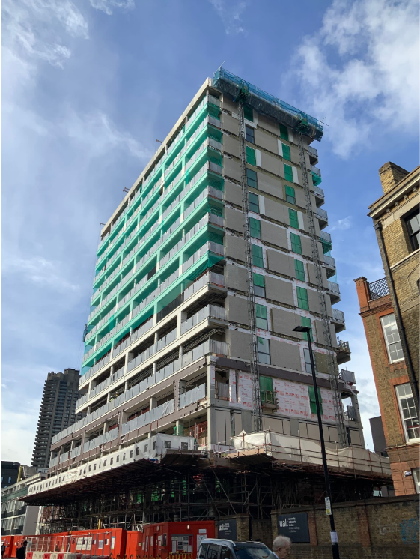
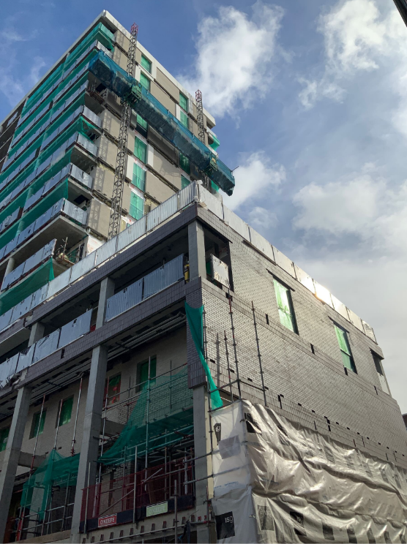
Residential Building: External Elevations
North elevation South elevation

Slide 4
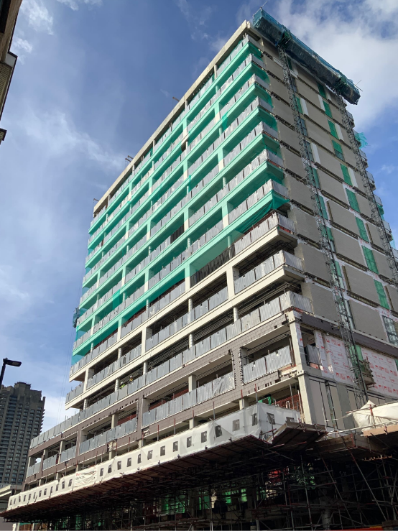
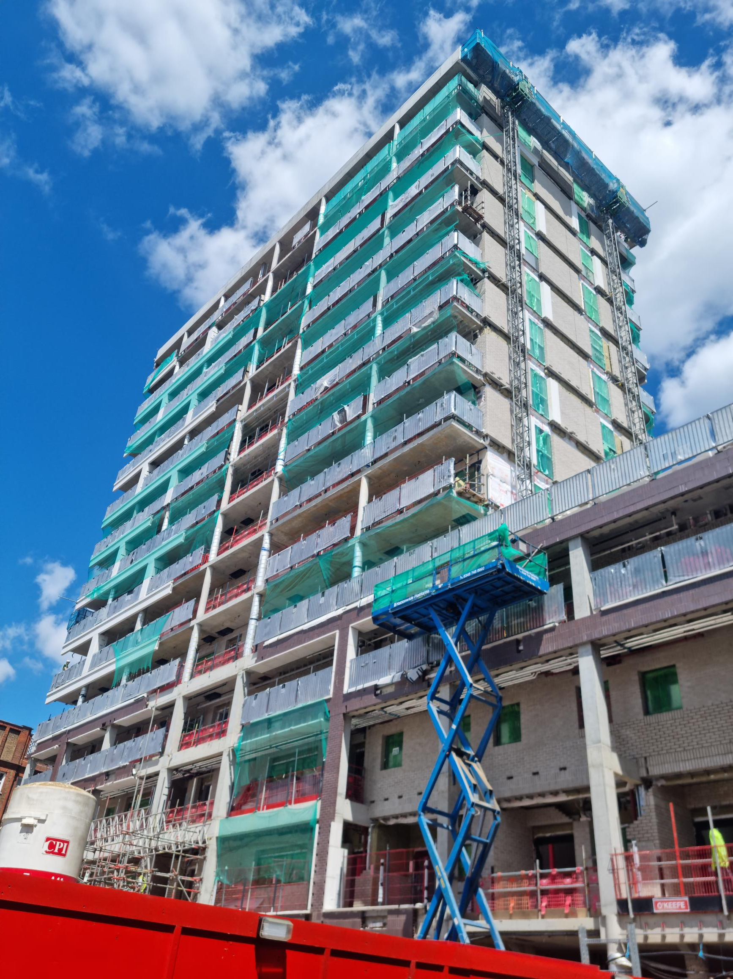
Residential Building: External Elevations
East elevation West elevation

Slide 5
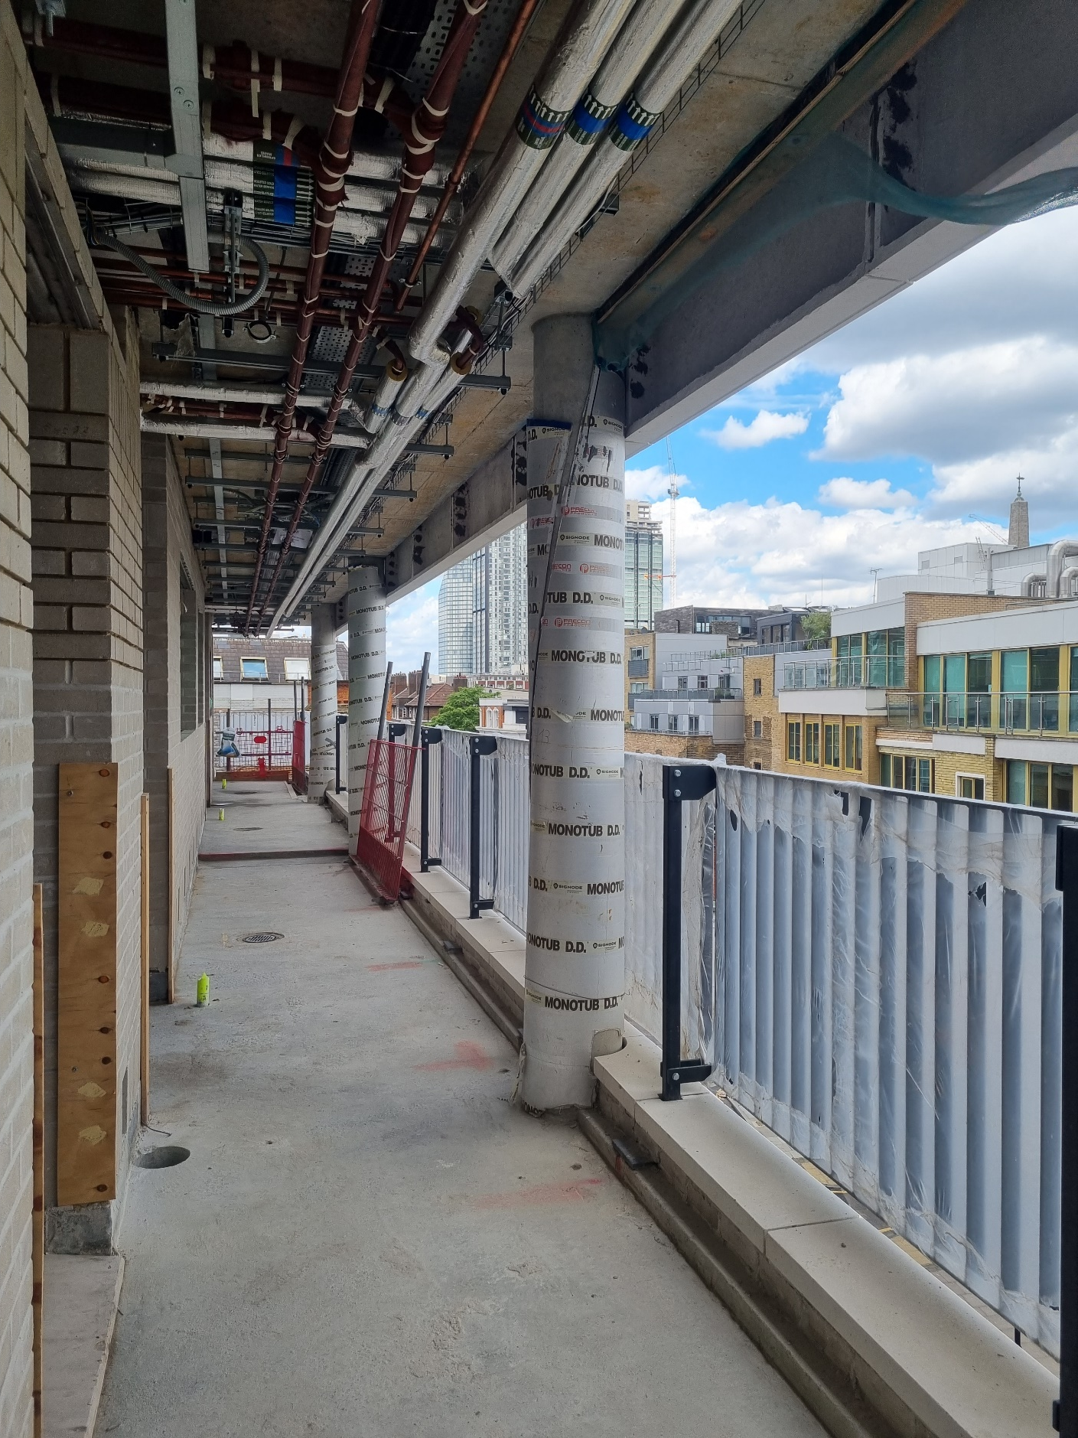
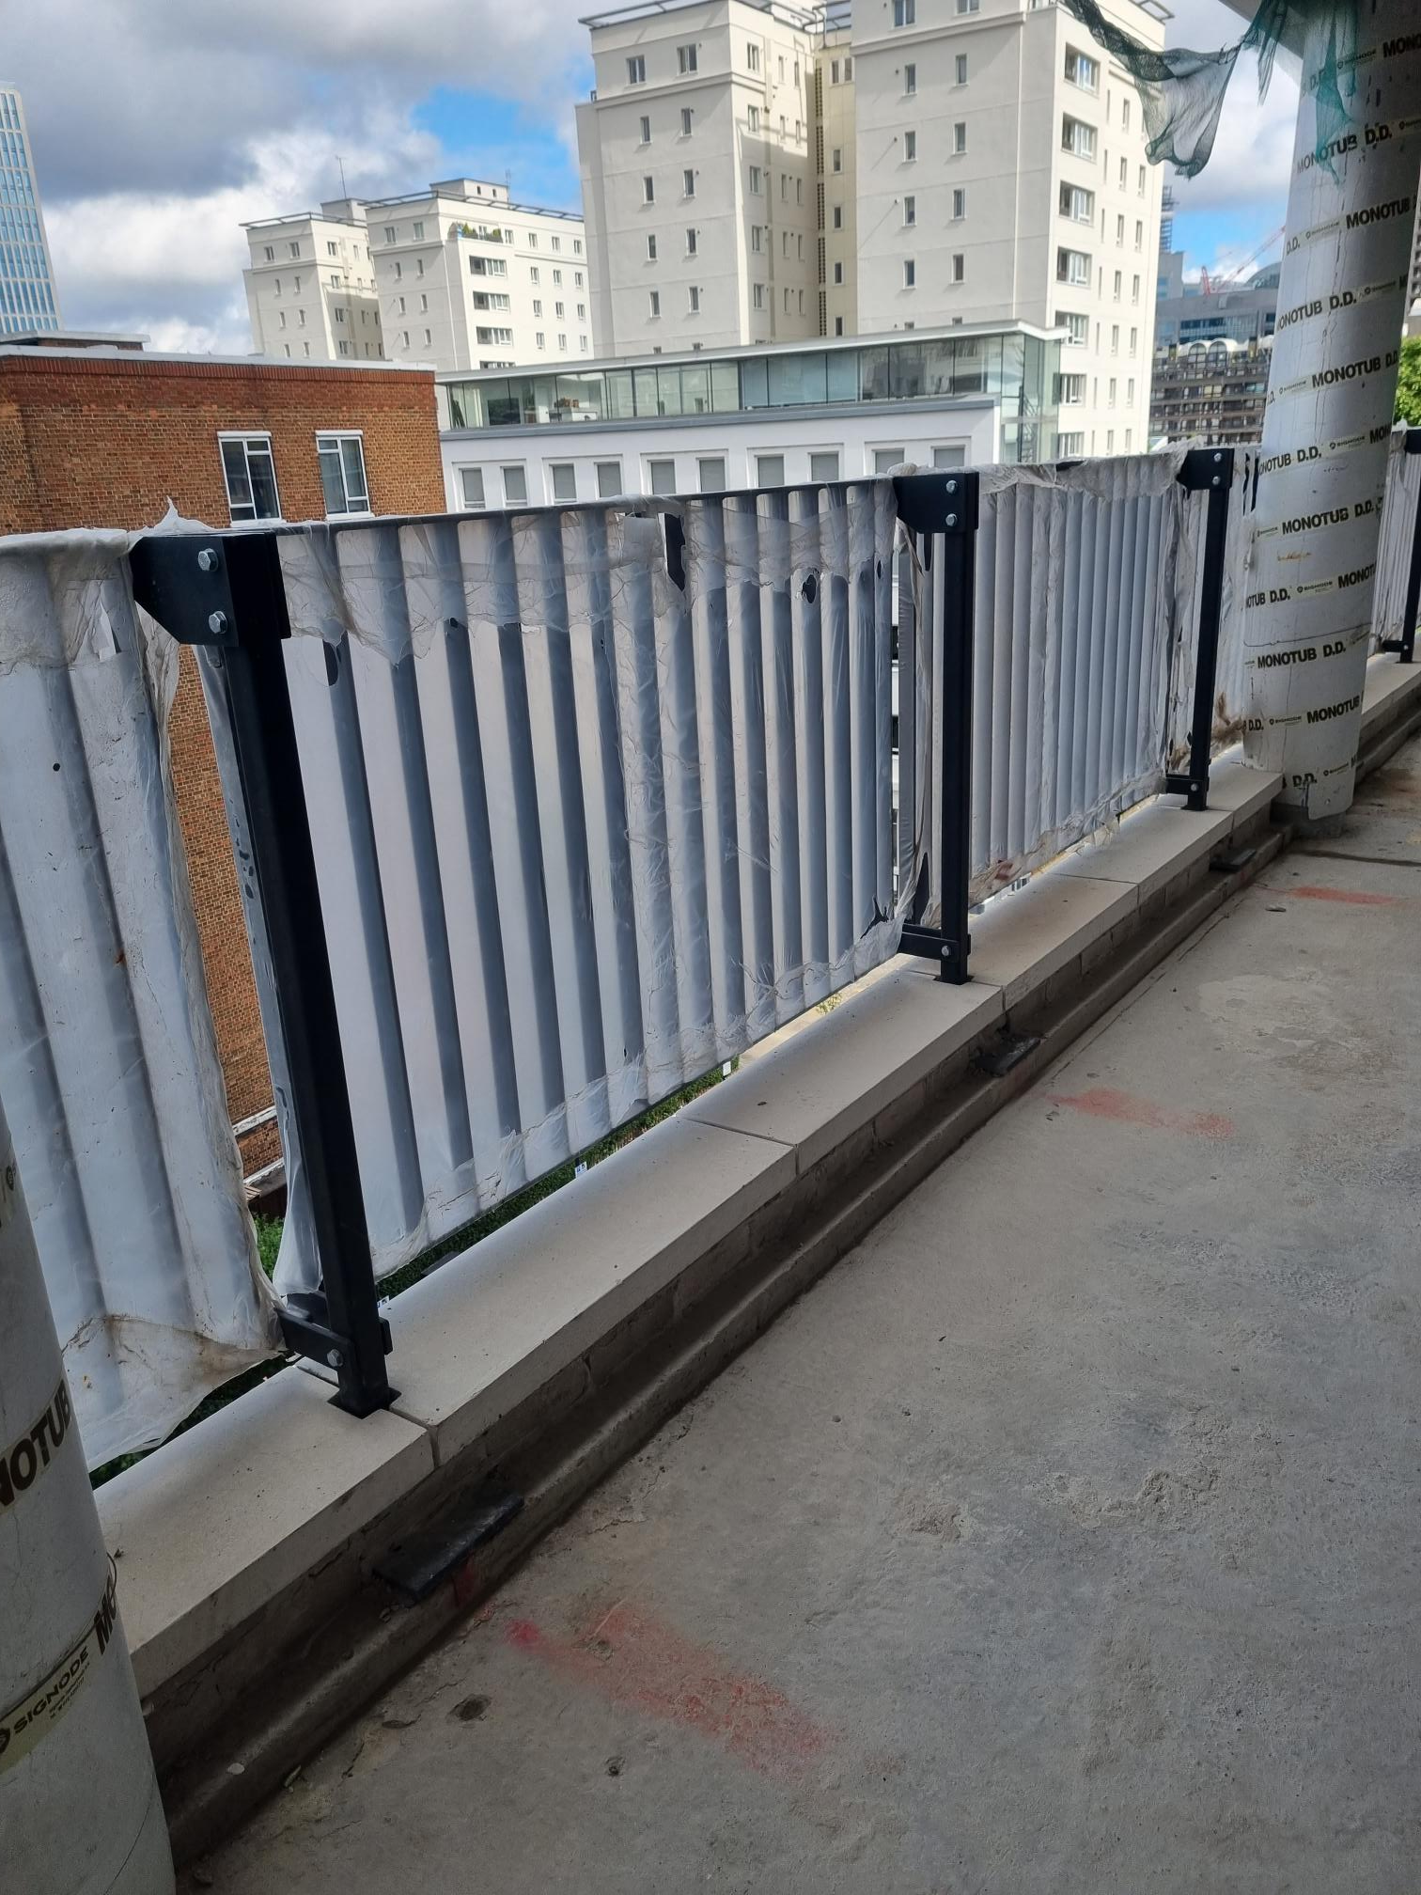
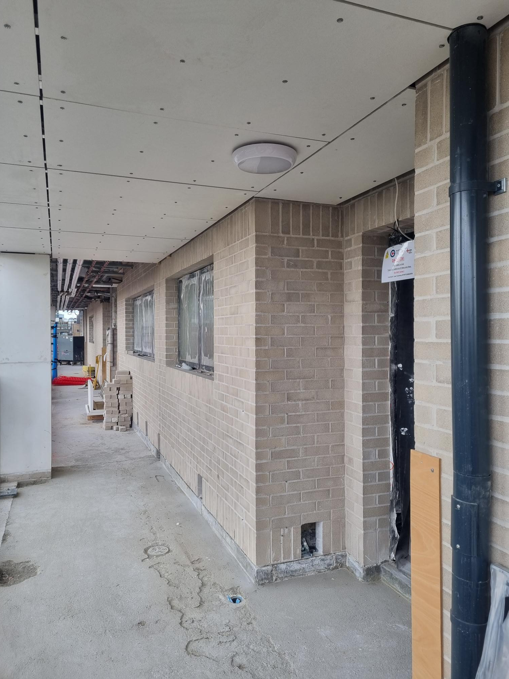
Residential Building: External Areas
Walkway soffit and lighting
Walkway mechanical, electrical, and plumbing (MEP) services
Balustrade and glass-reinforced concrete (GRC)

Slide 6
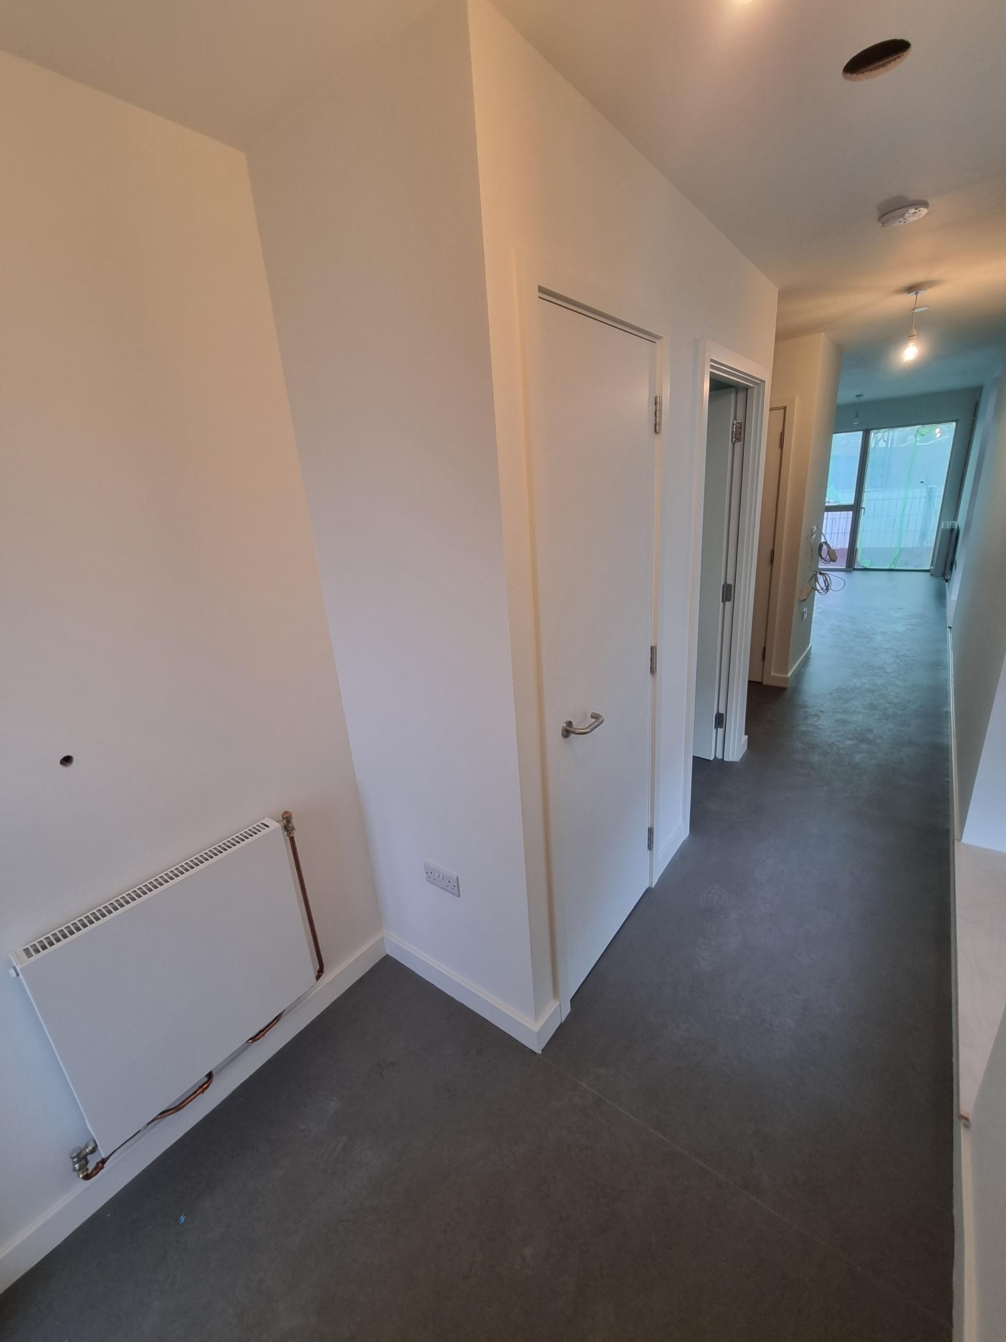
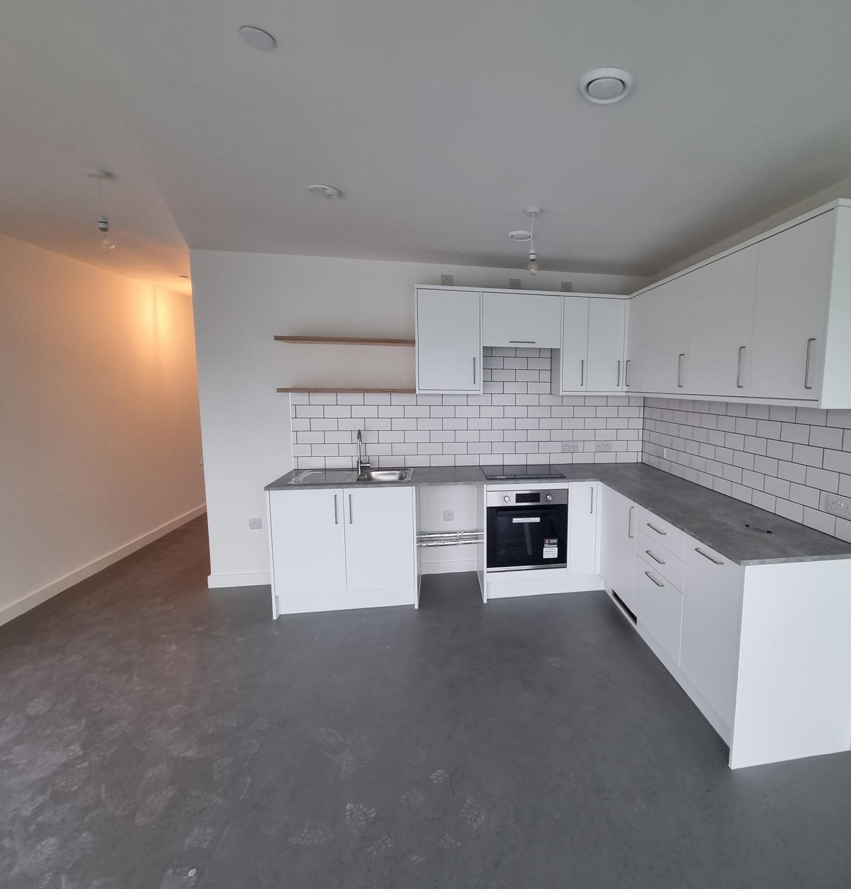
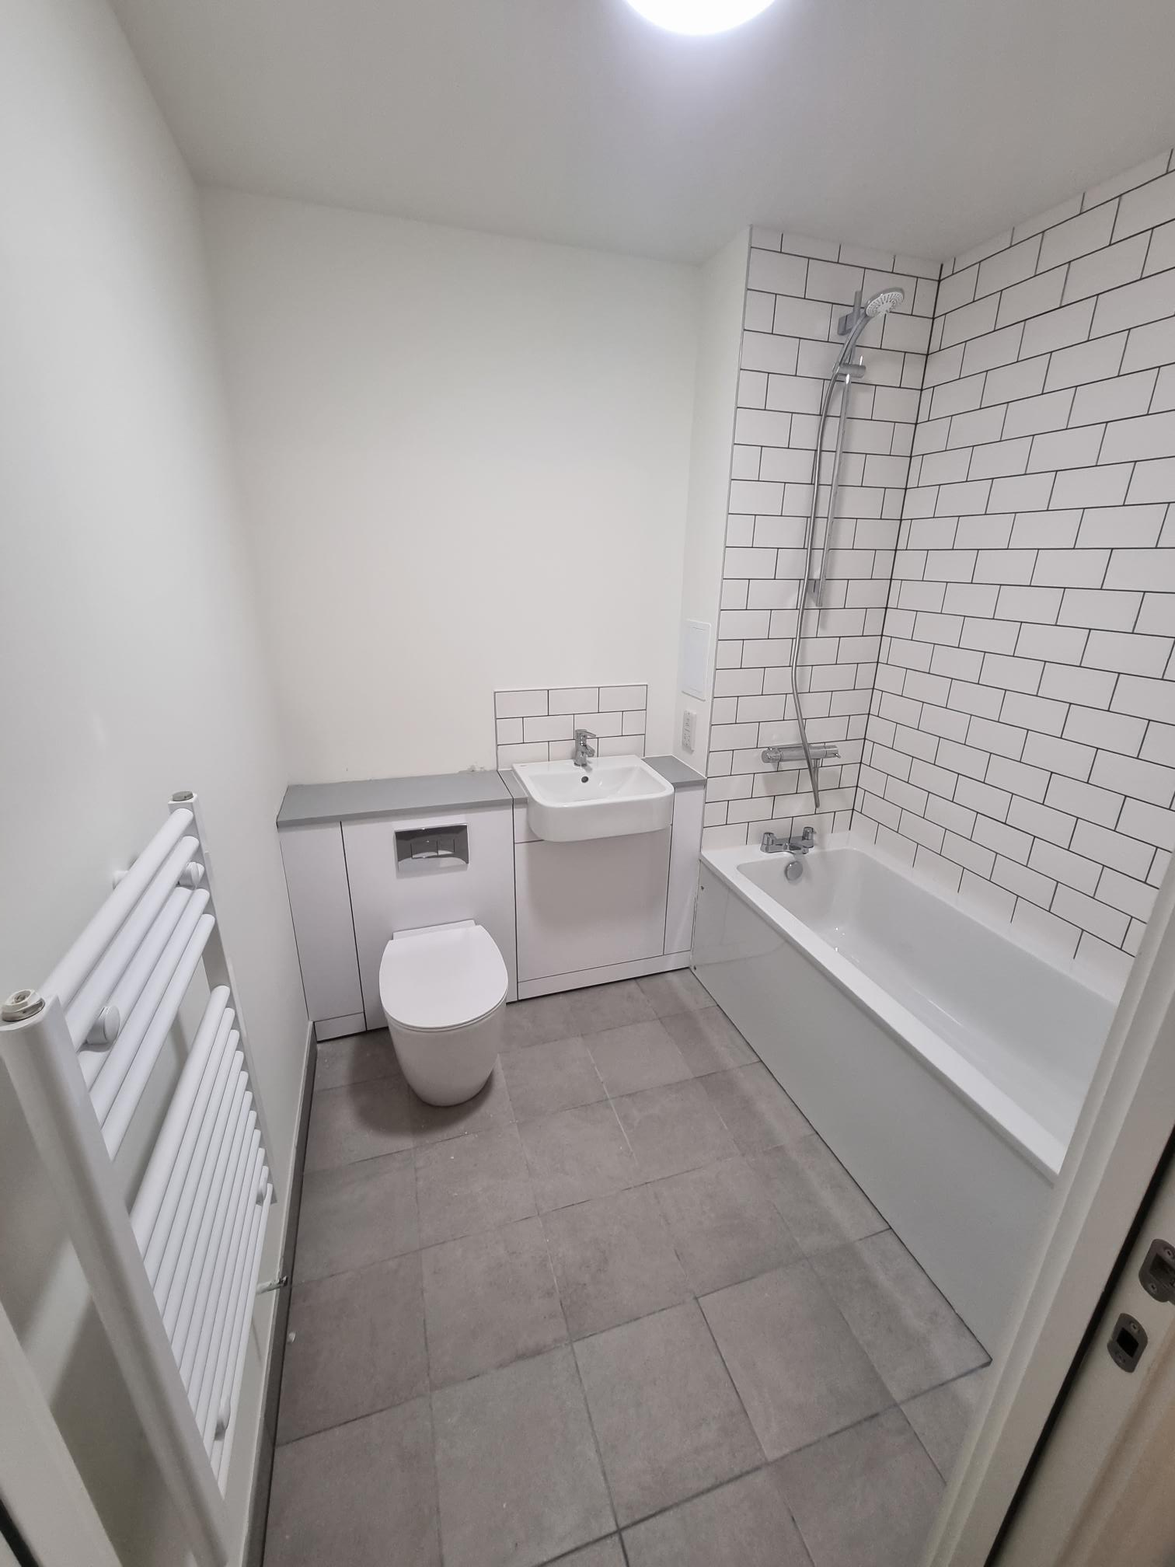
Residential Building: Internals – Sample Home
Flat entrance Kitchen / dining room Bathroom

Slide 7
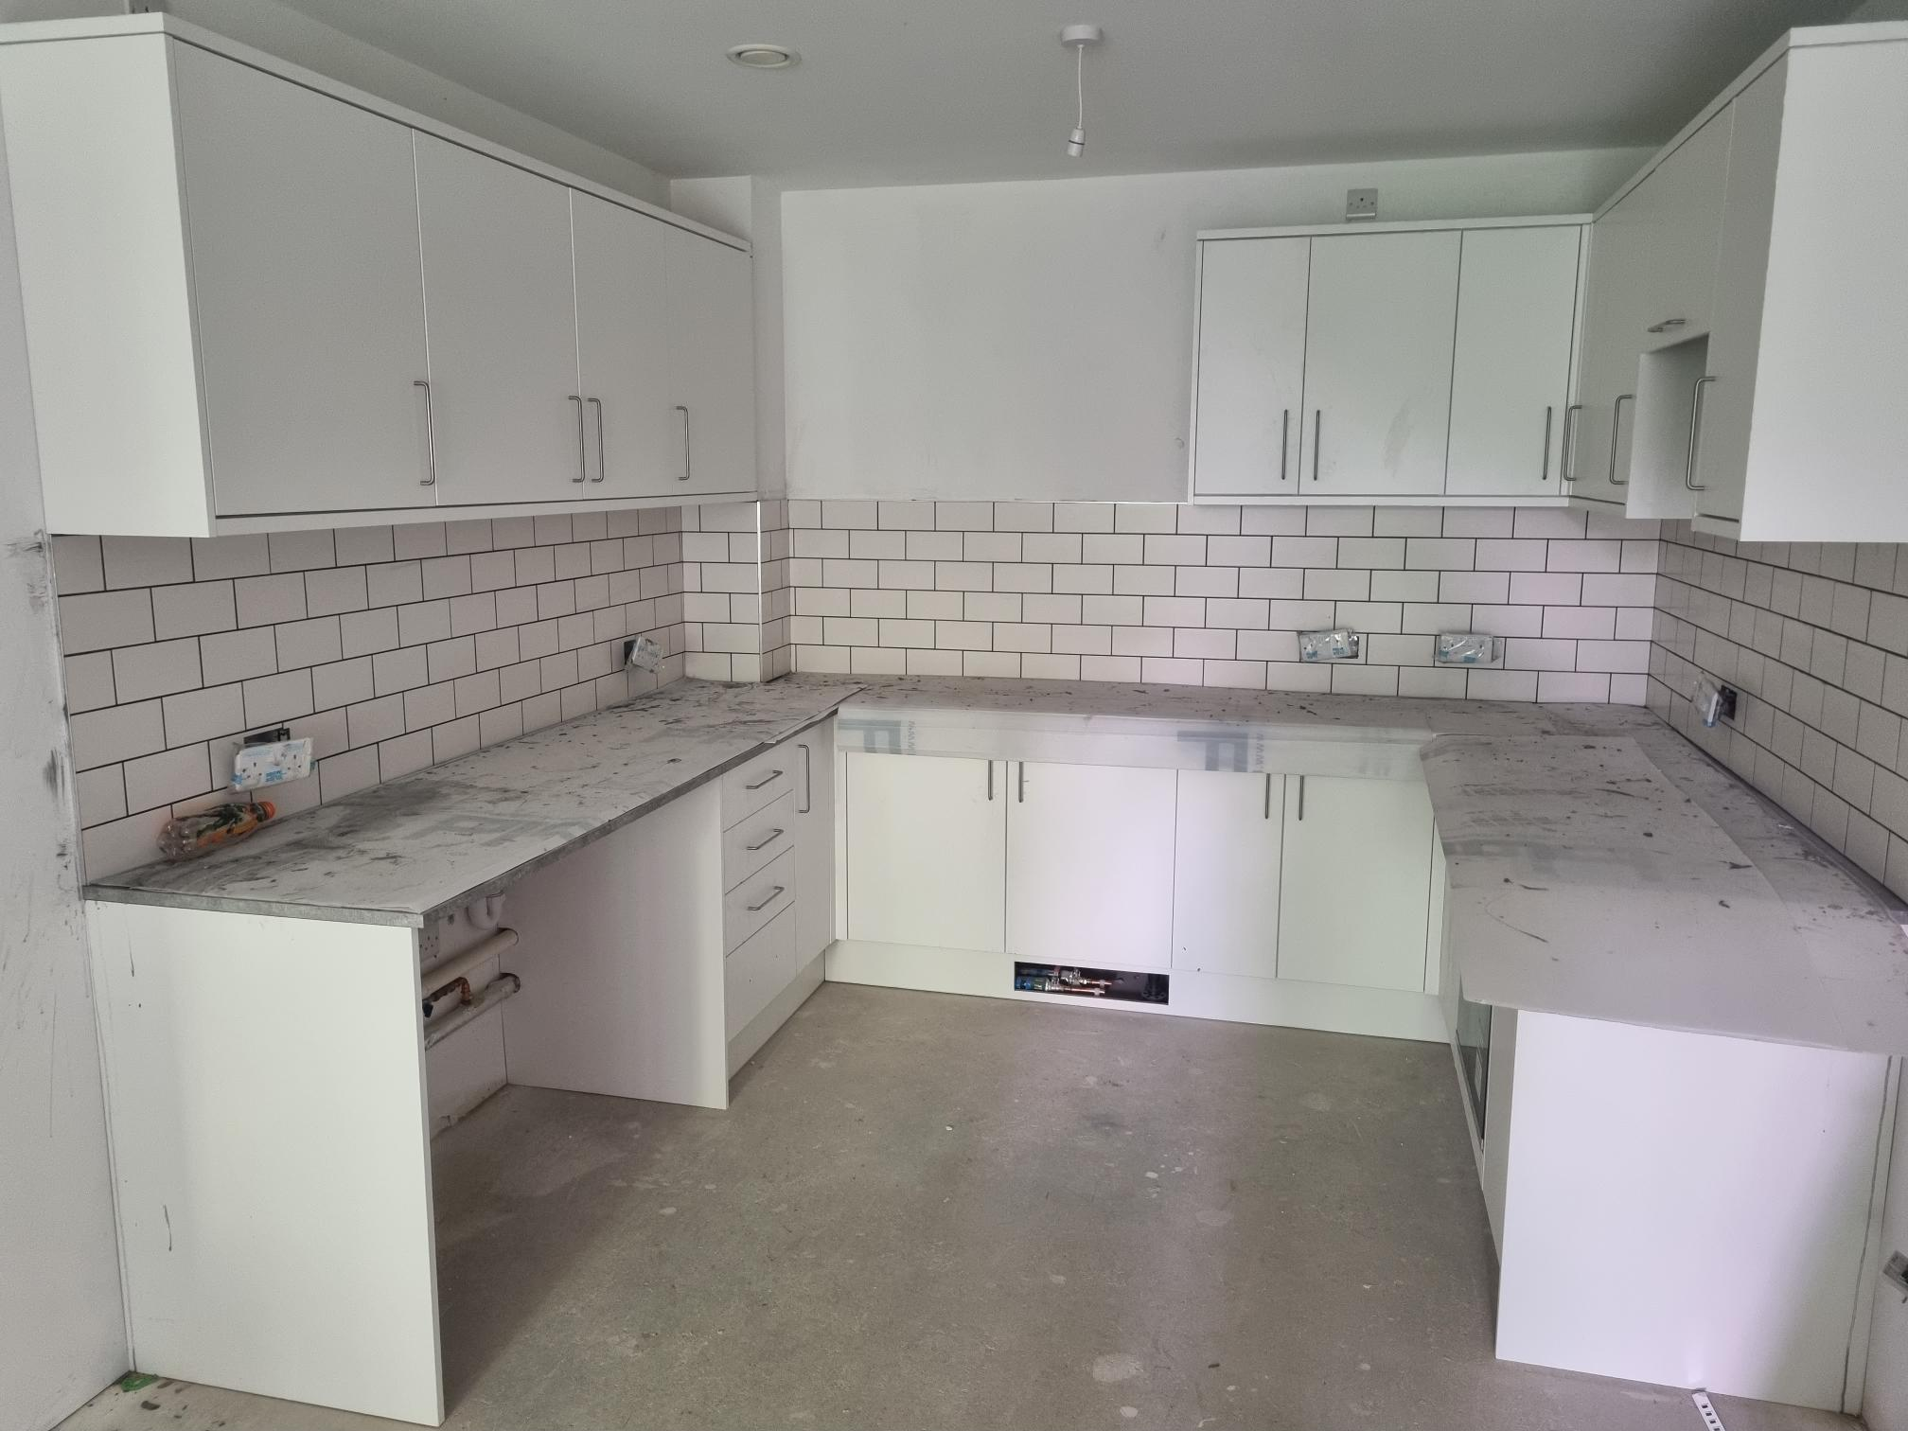
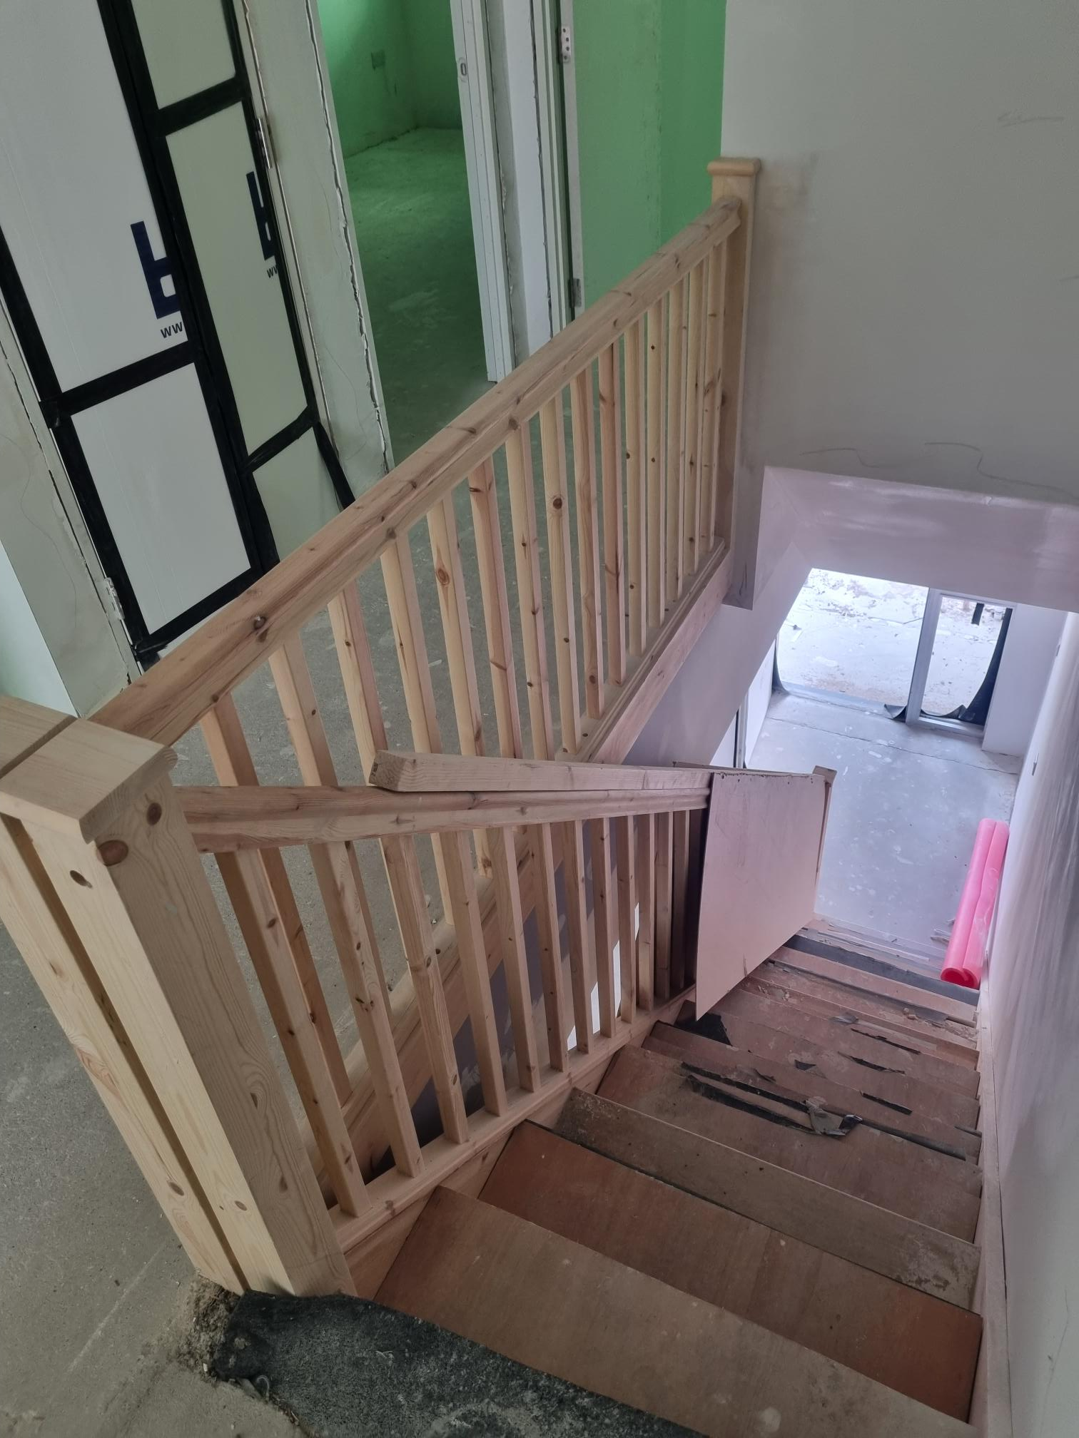
Residential Building: Internal – General Progress
Duplex staircase Kitchen

Slide 8
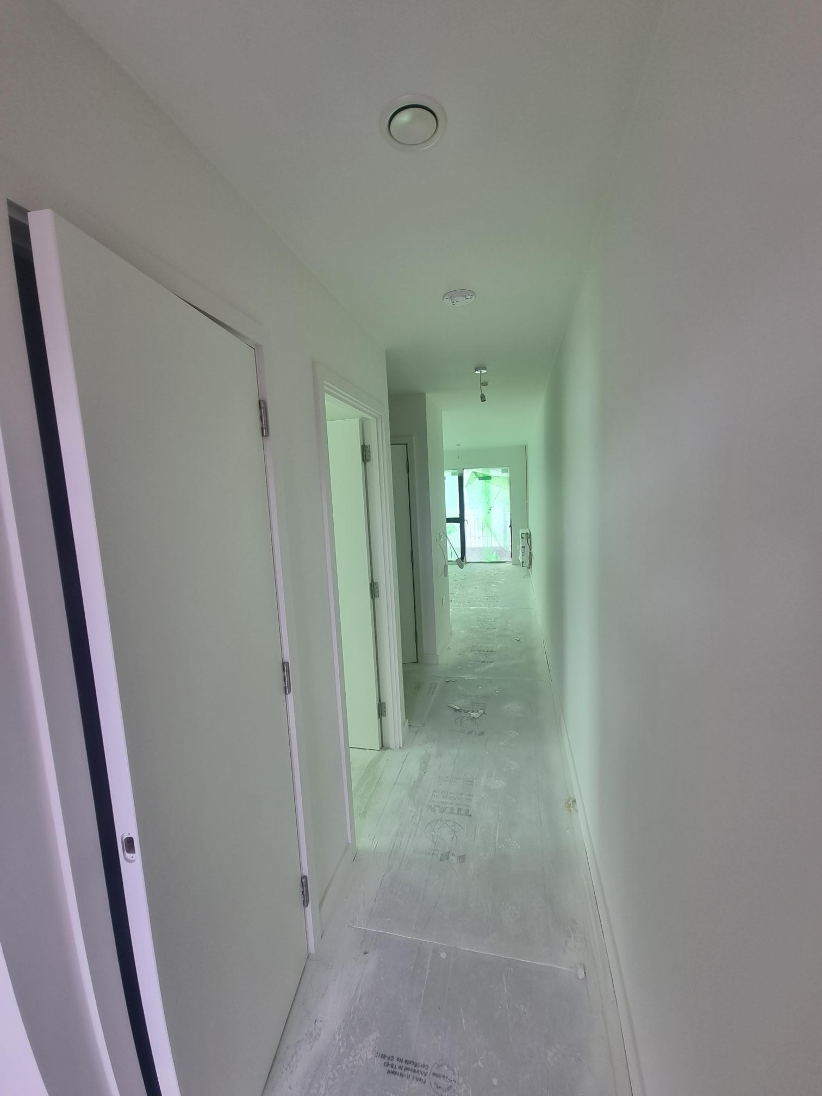
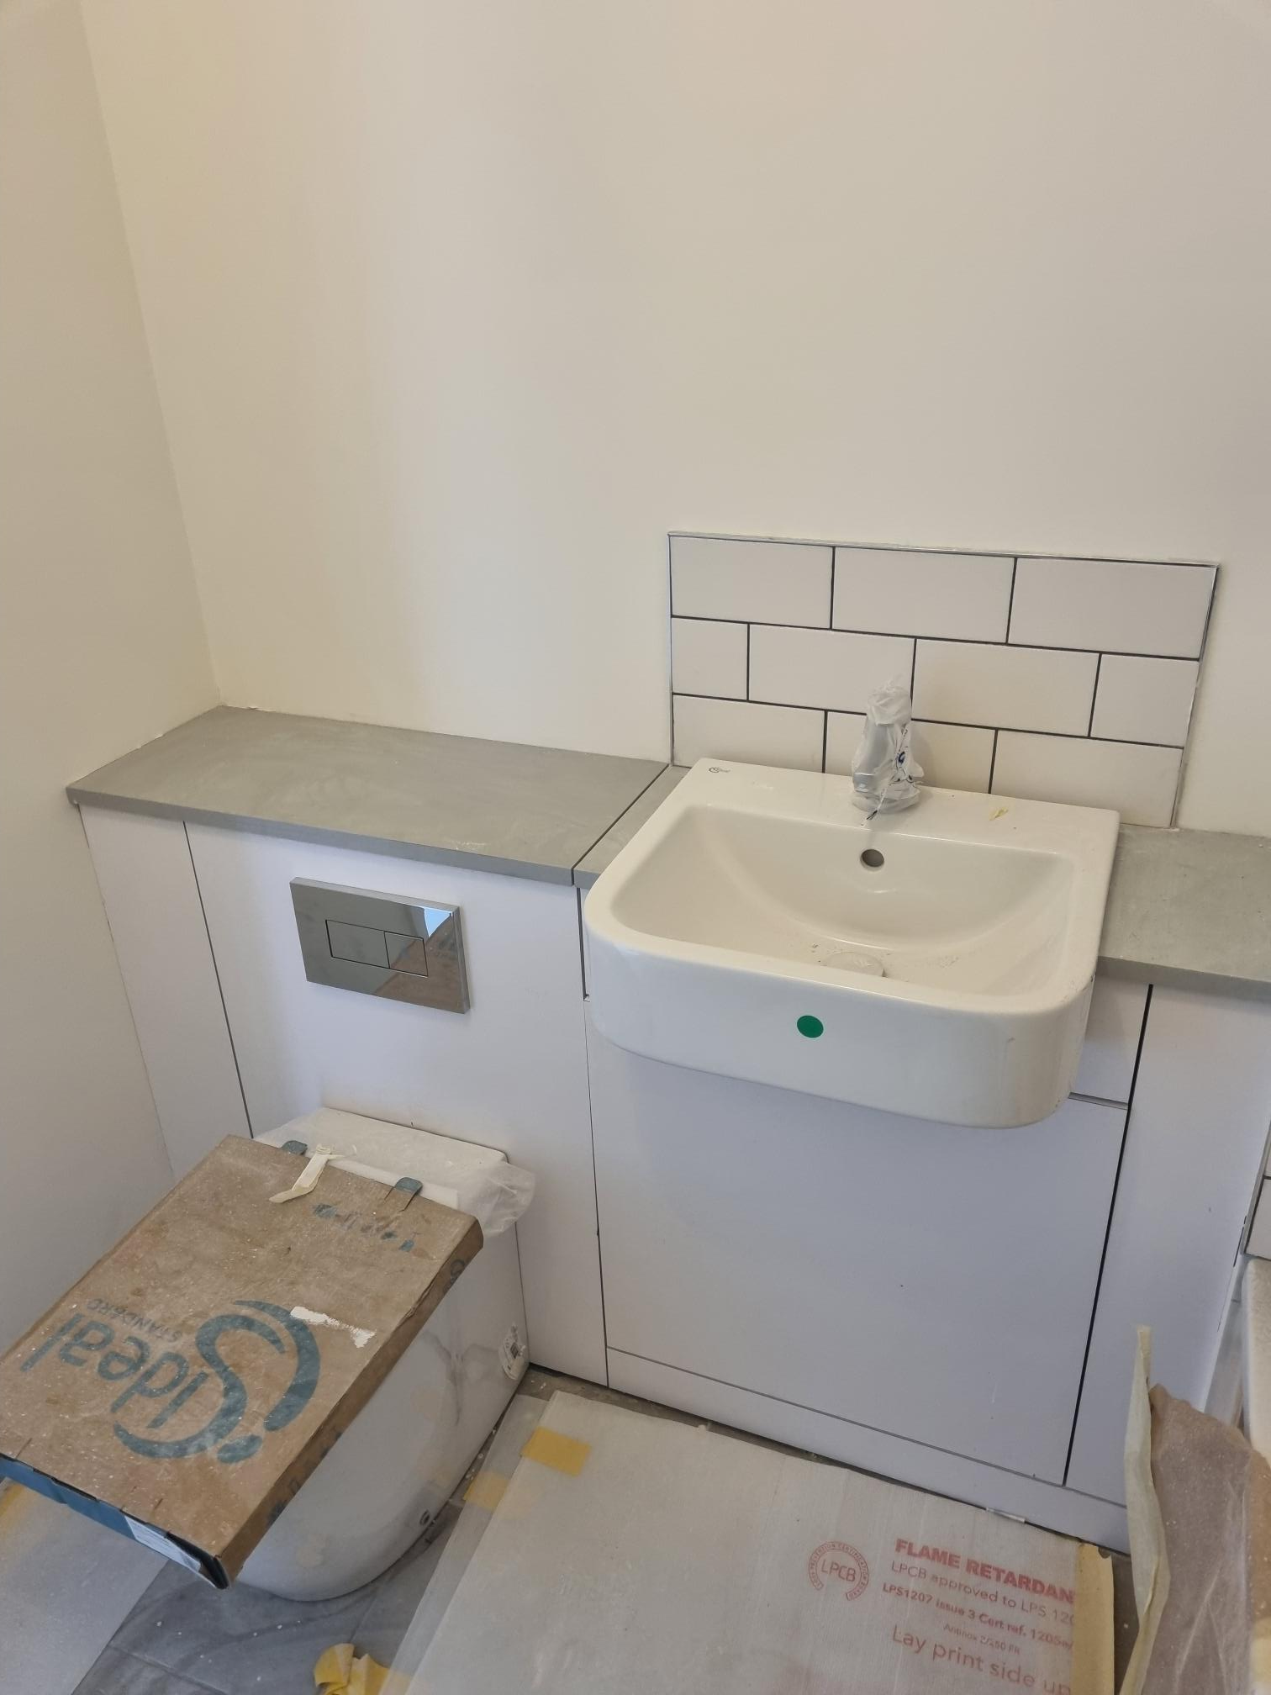
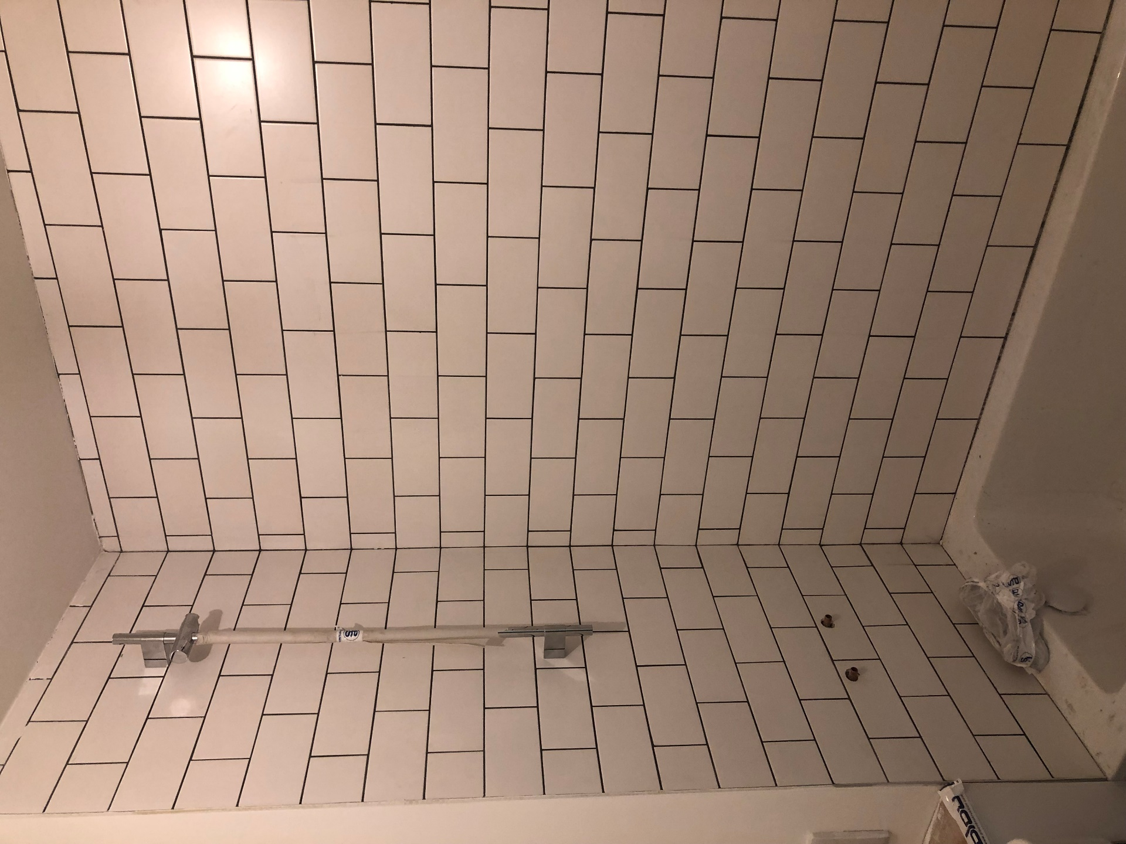
Residential Building: Internal – General Progress
White boxed hallway Bathroom basin and pan Bathroom bath tiling surround

Slide 9
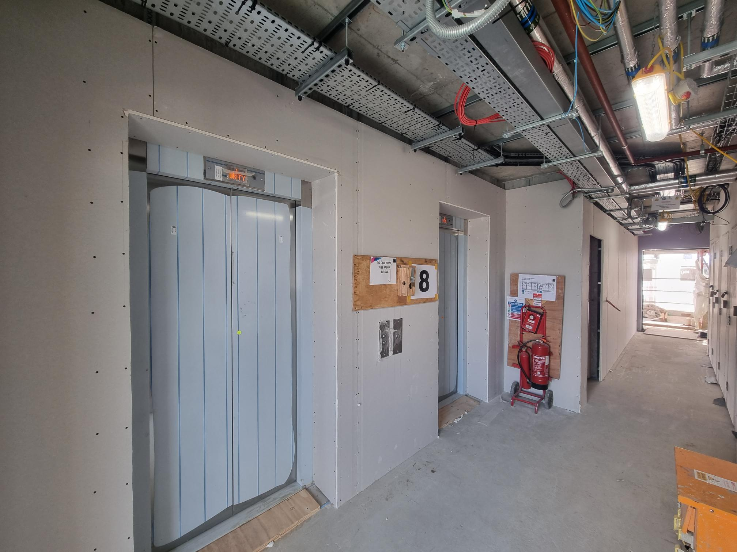
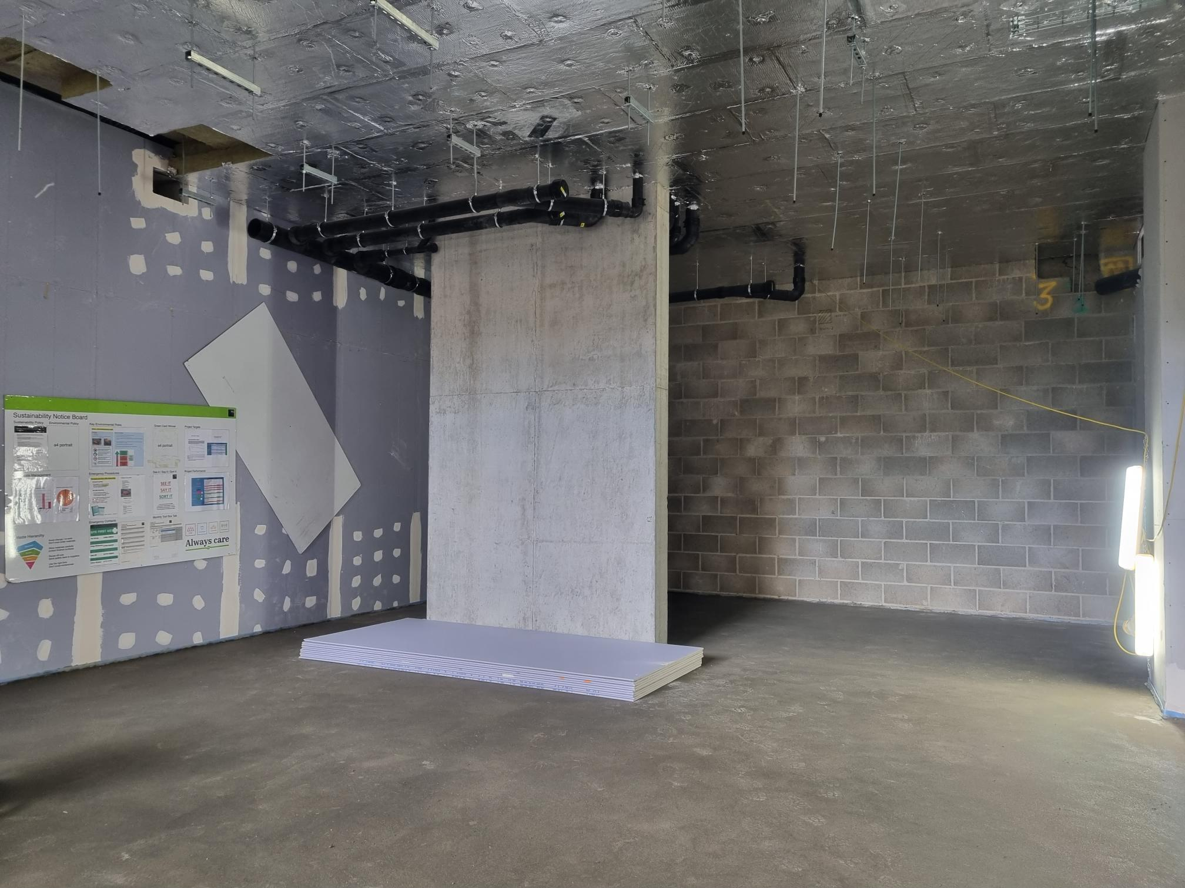
Residential Building: Internal – General Progress
.
Lift lobbies Ground floor workspace screed and high level services

Slide 10
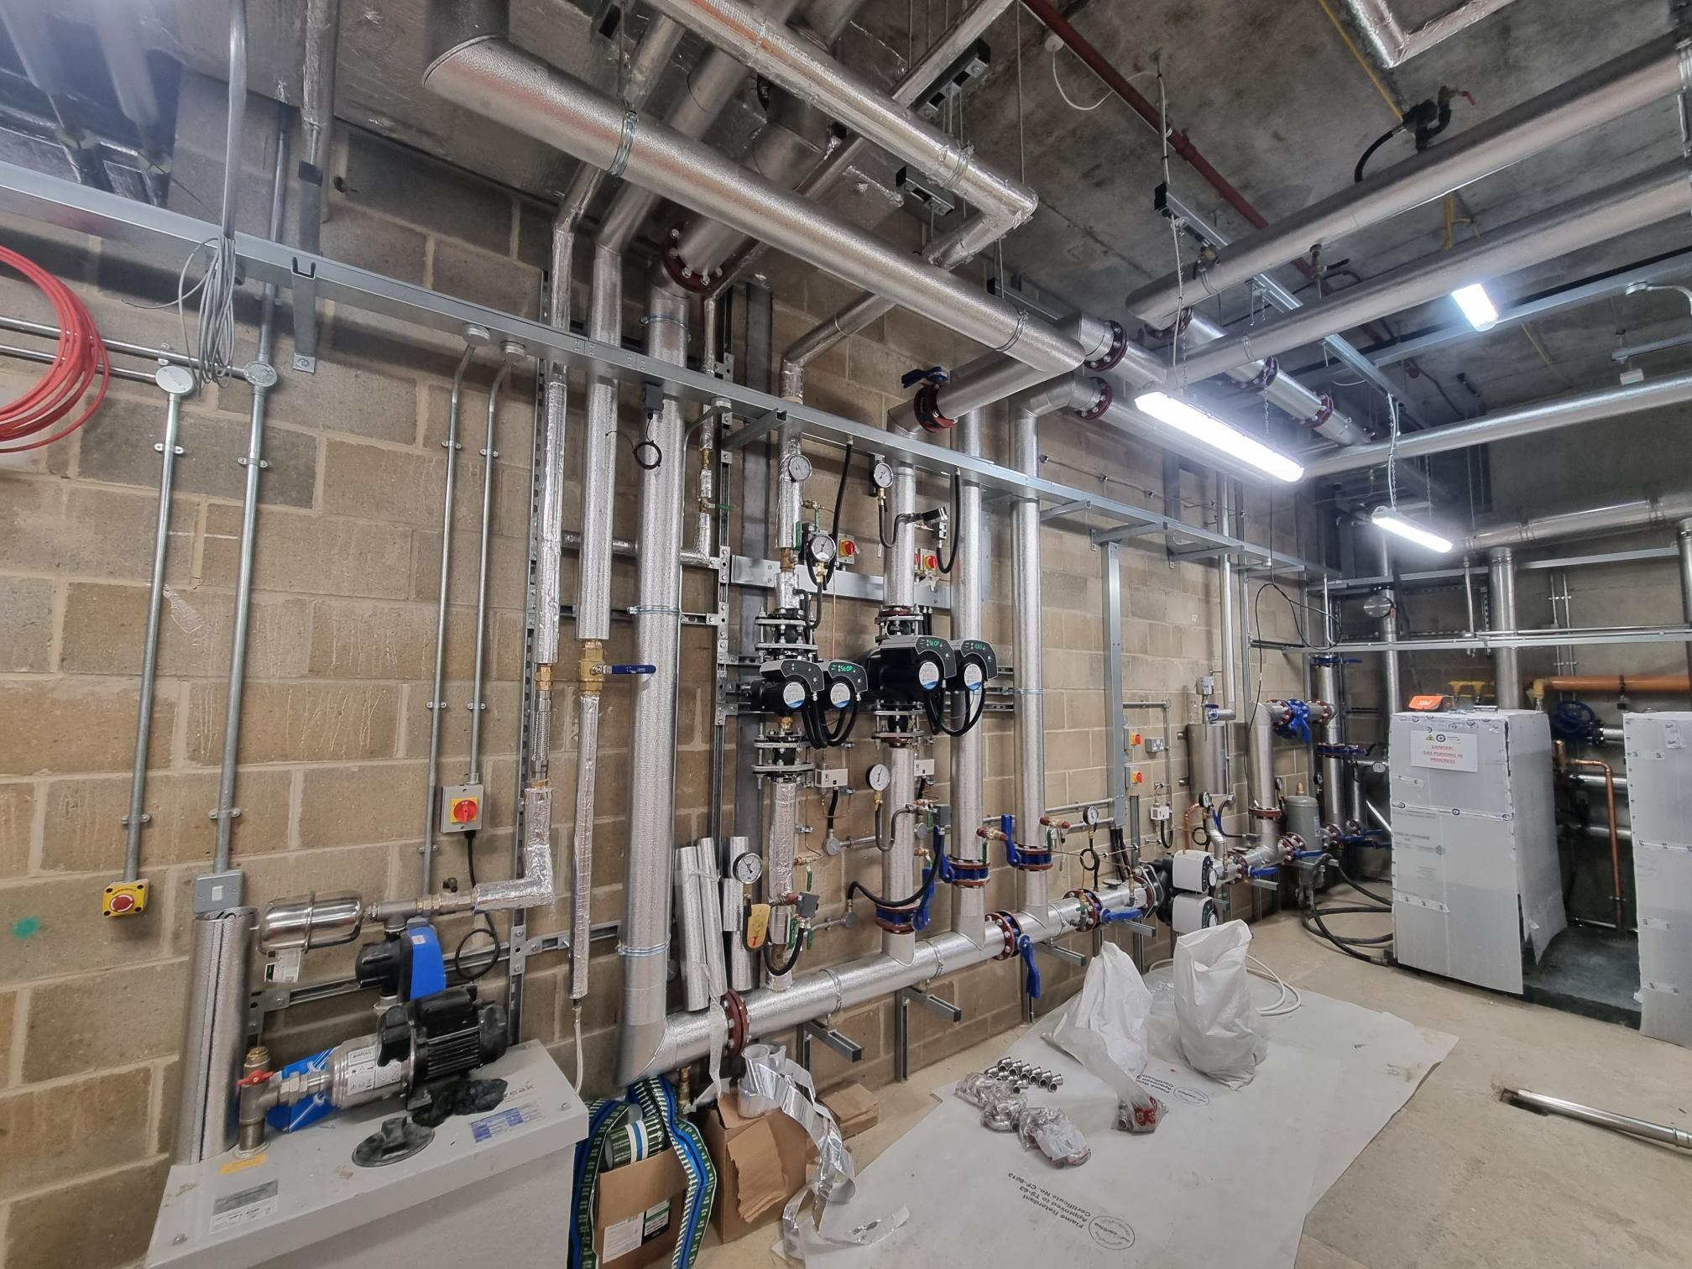
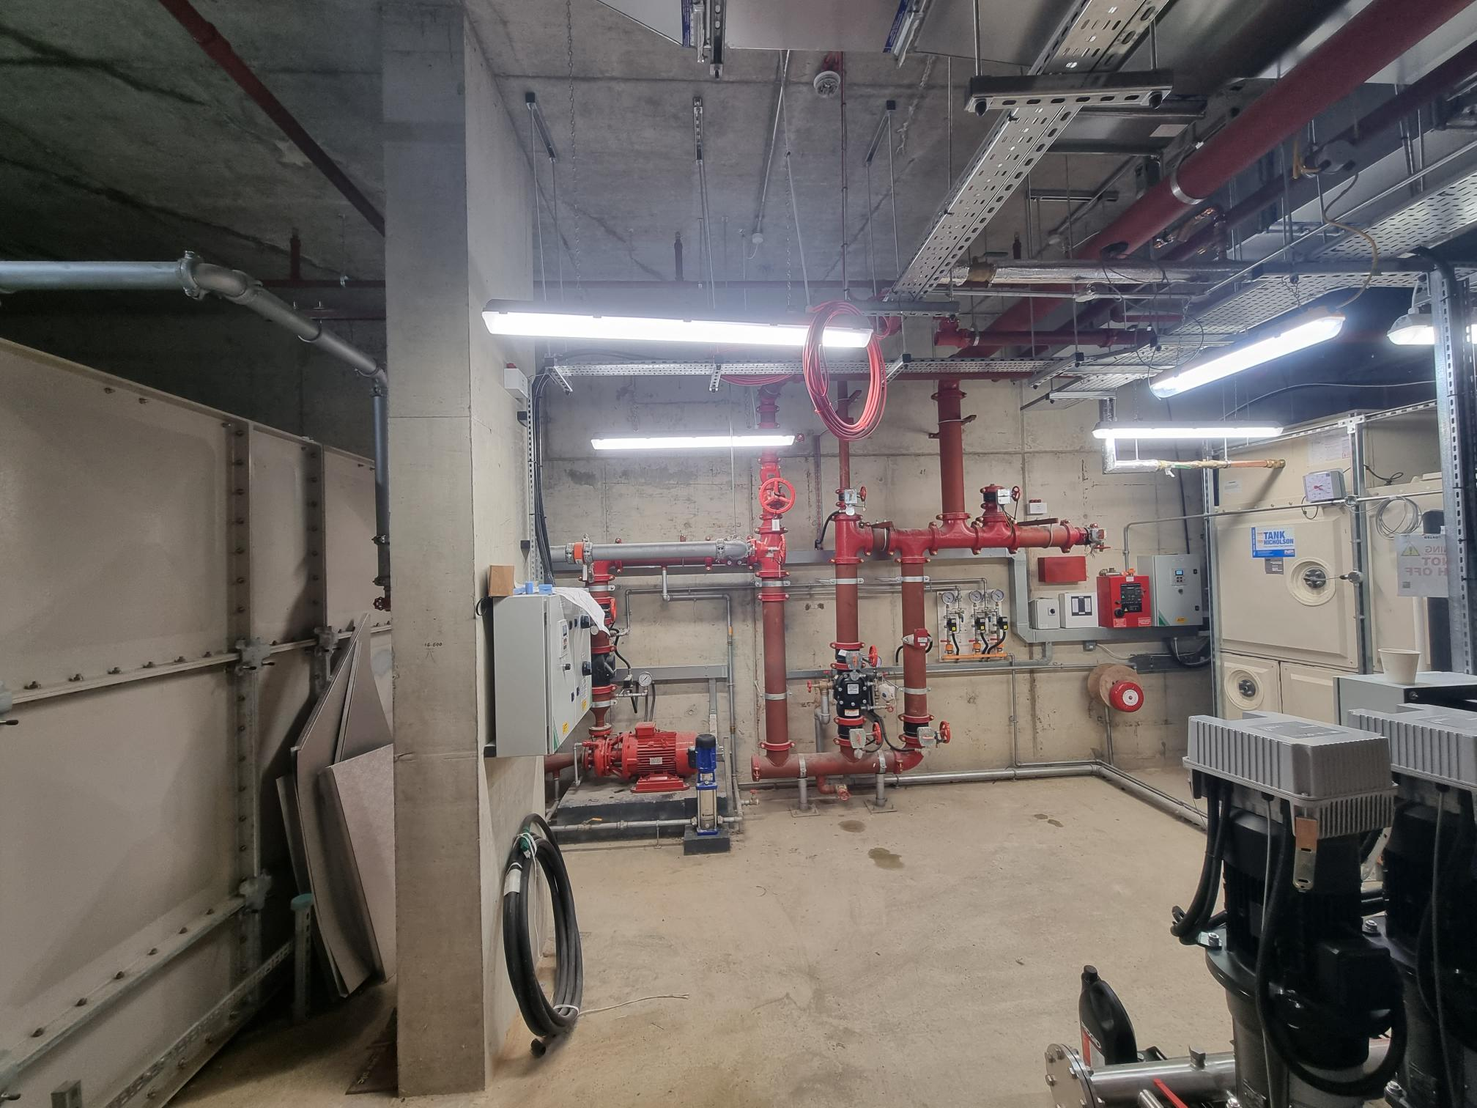
Residential Building: Internal – Basement
Boiler room Sprinkler room

Slide 11
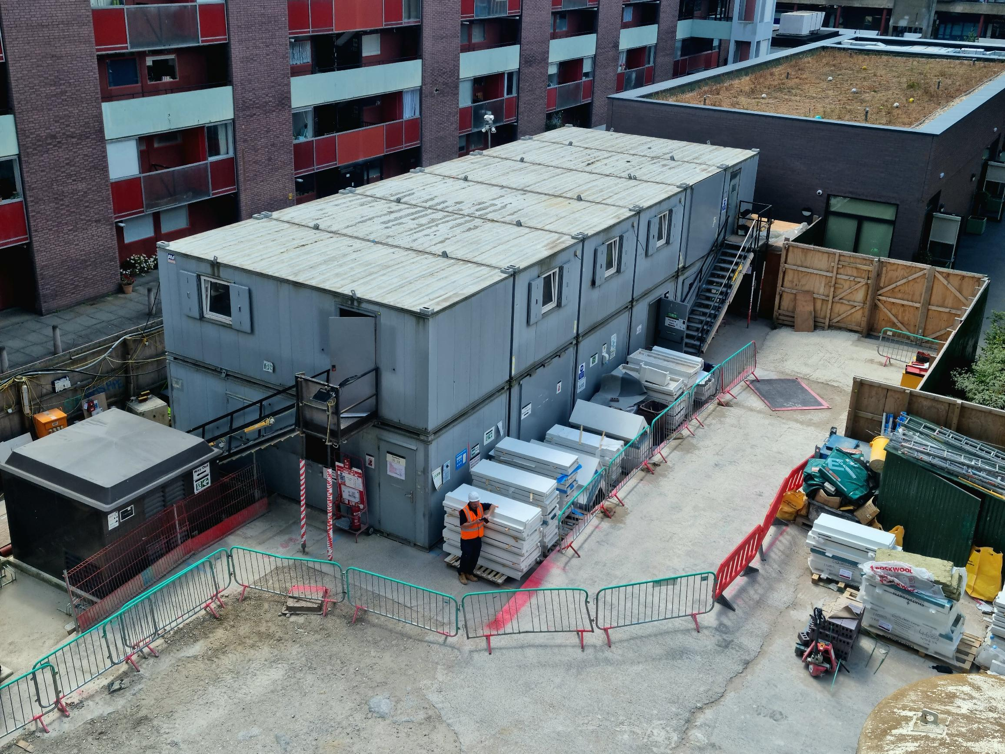
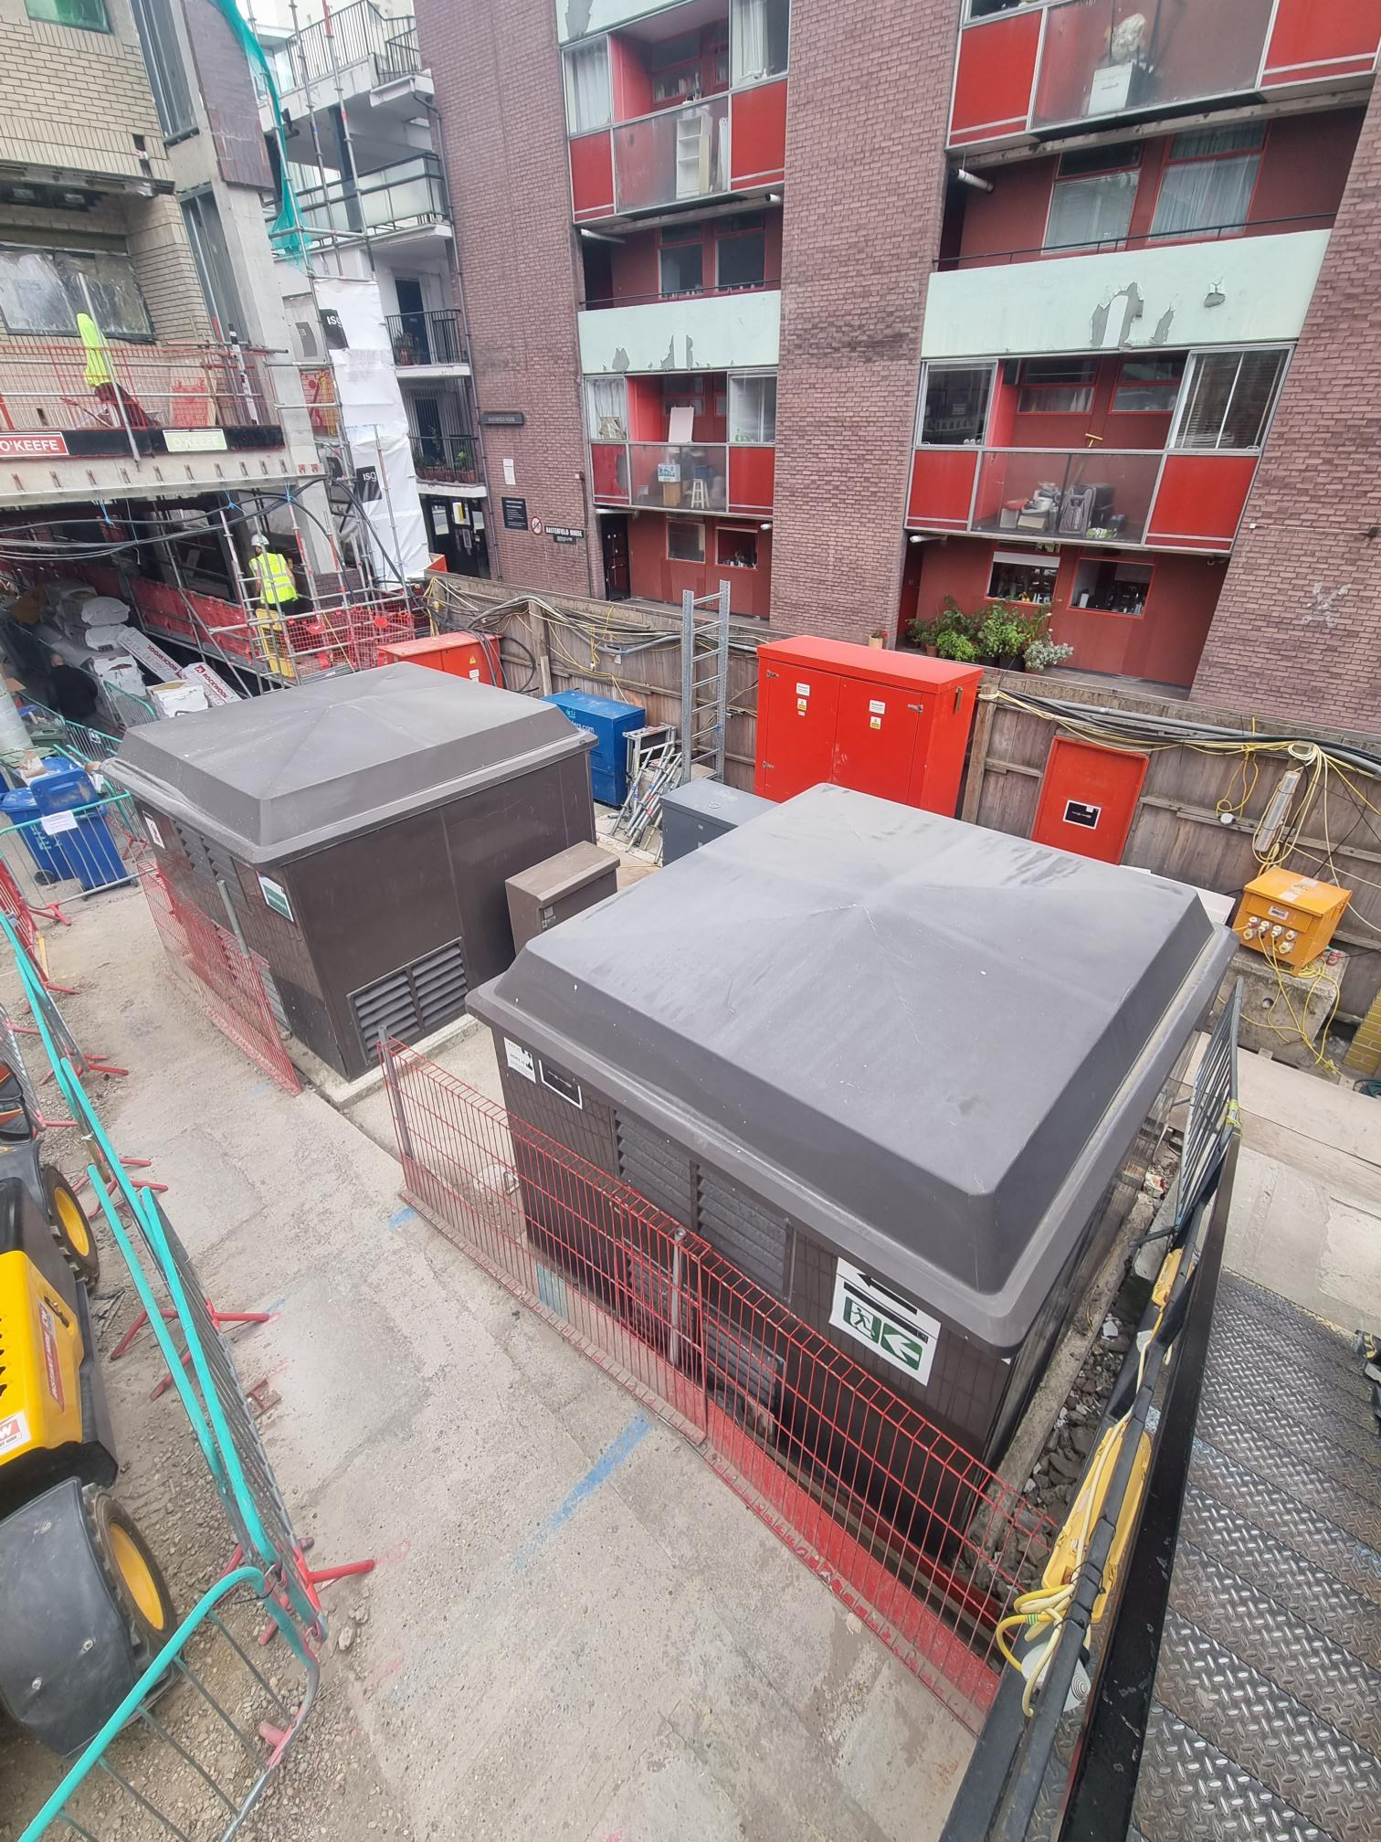
Residential Building: Significant upcoming works in July
Welfare cabin Removal Substation removal

Slide 12
Working Hours And COVID-19 Guidance
Working hours
Monday to Friday
8am - 6pm
Saturday
9am - 2pm
HSE guidelines and support
https://www.hse.gov.uk/coronavirus/working-safely/index.htm
Government guidelines
https://www.gov.uk/coronavirus

Slide 13
Project Timeline
Completion: November 2022
Key Milestones:
Removal of hoist and mast climbers to east and west elevations in July 2022
Removal of site huts in July 2022
School entrance operational from Golden Lane upon completion.

Slide 14
Name Our New Residential Building
Iron Foundry Court (there are records of an iron foundry on the site circa 1894)
Cherry Tree Court (a street name from the 1800s)
Domingo House (named after the historic Domingo Passage)
Black Swan Court (named after the historic Black Swan Court)
Schoolhouse Court (due to the building’s proximity to the school).
Vote by visiting our website: www.colpai-project.co.uk or call 0800 772 045.
Please call or email info@colpai-project.co.uk if you have any questions.
You can vote up until 27 July 2022.

Slide 15
Q&A

