Slide 1
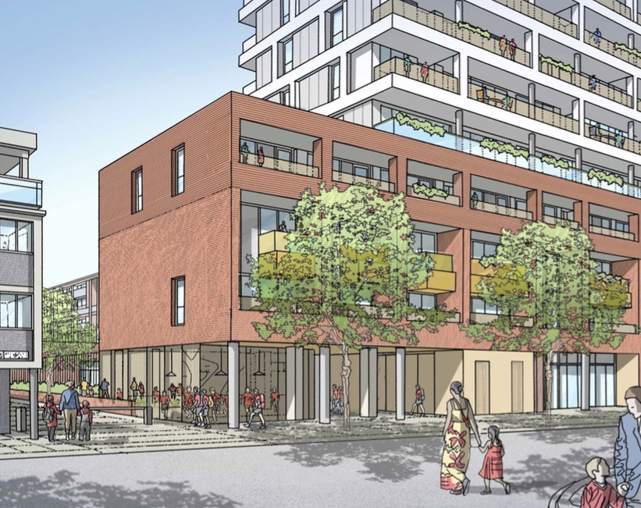
COLPAI Project: Progress Of Works
Online public webinar
Wednesday 07 April 2022, 7pm

Slide 2
Webinar Protocol
The project team is available to discuss and answer questions regarding progress with the works on-site only
This meeting is not designed or intended to be solely a forum for debating planning related matters, which should be raised with the appropriate planning officers
We request participants be respectful to all attendees so the webinar runs smoothly.

Slide 3
Residential Building: - External elevations
North elevation South elevation

Slide 4
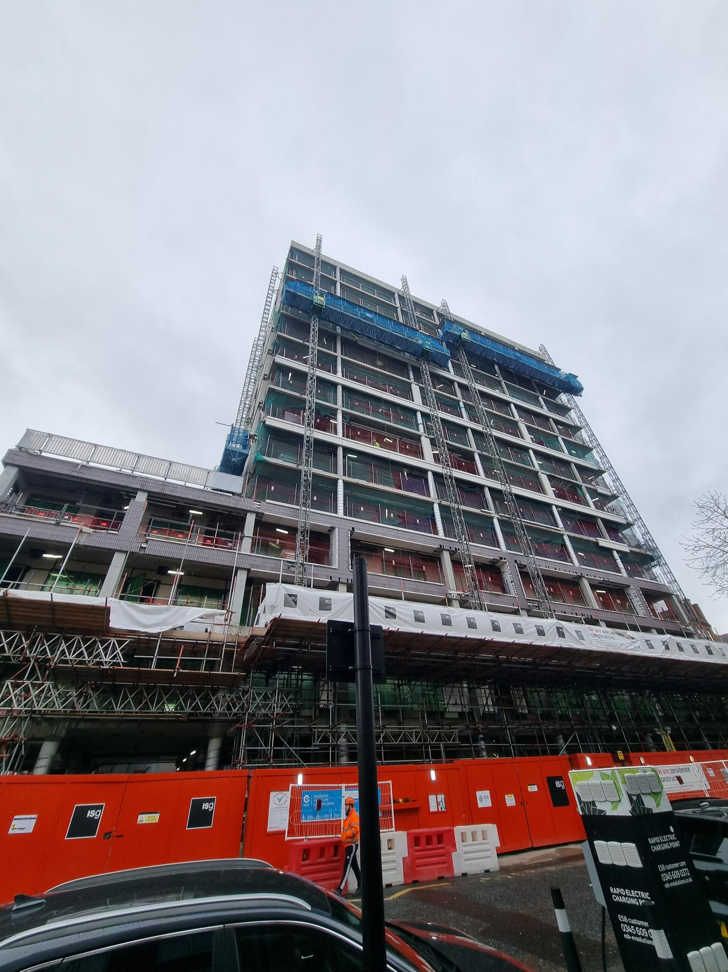
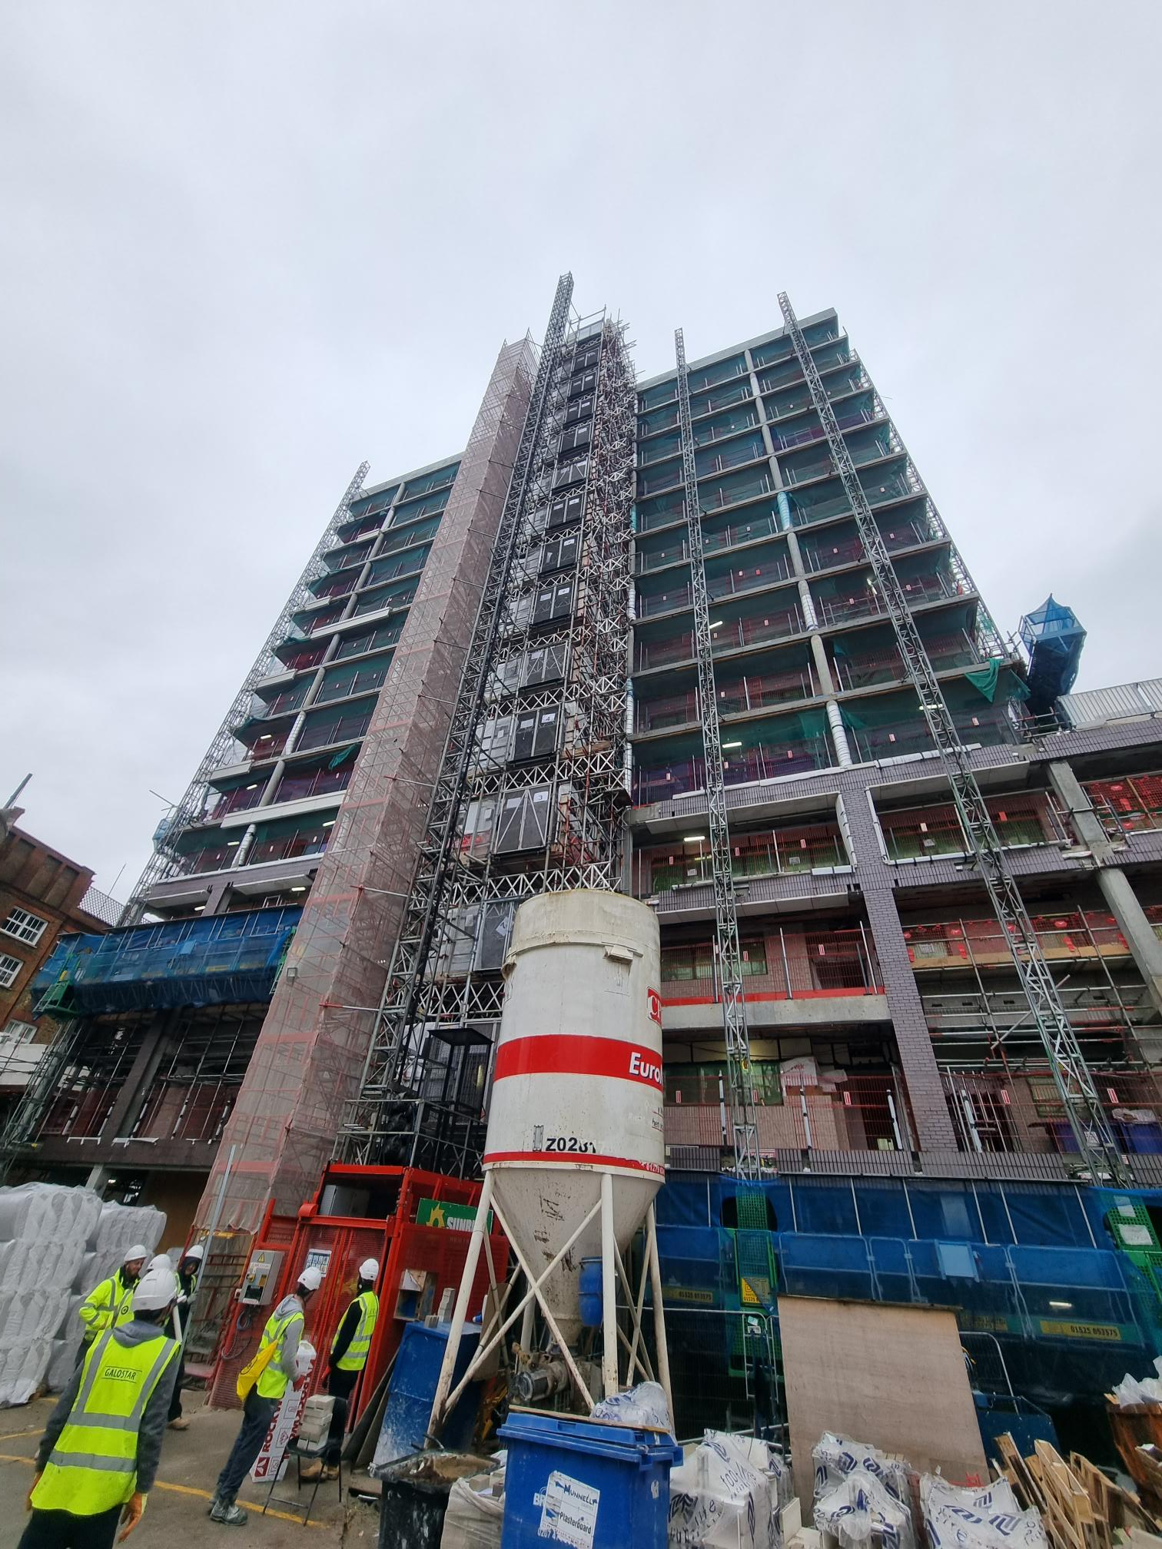
Residential Building: - External elevations
East elevation West elevation

Slide 5
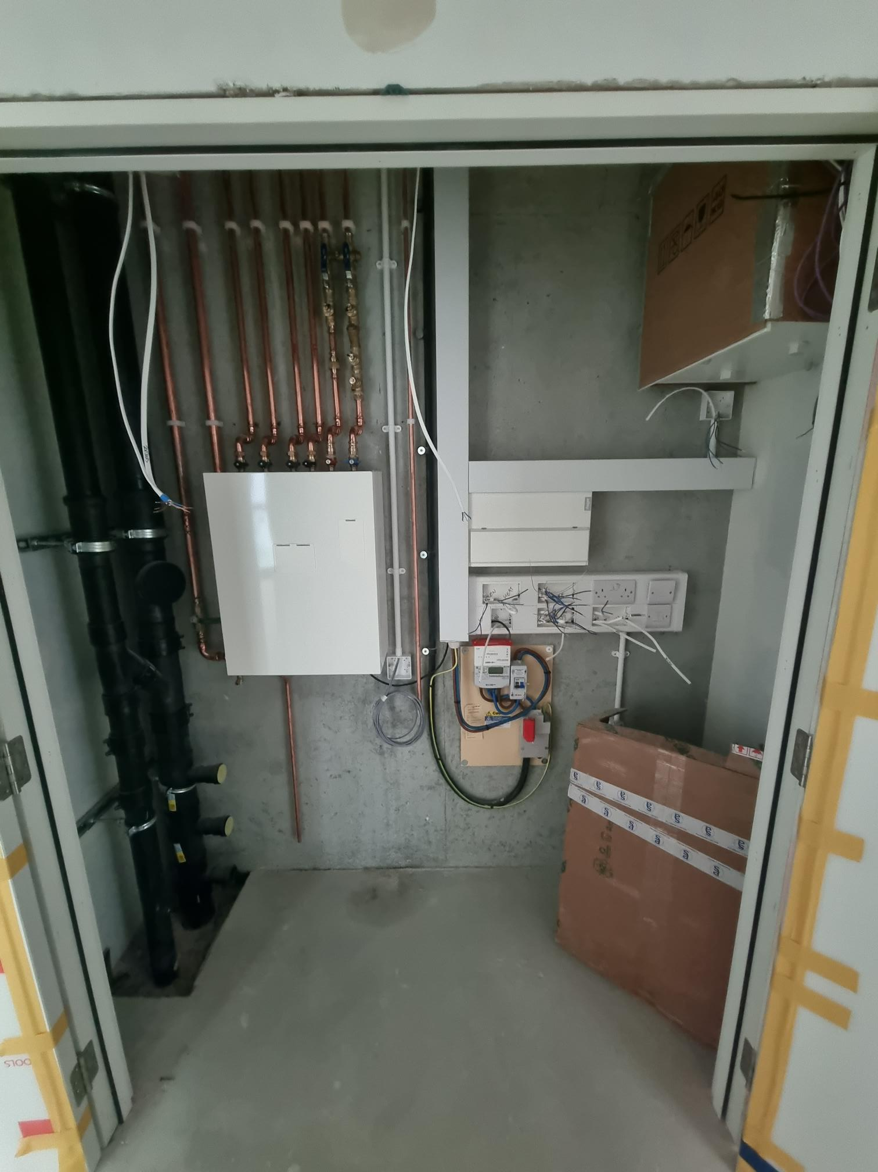
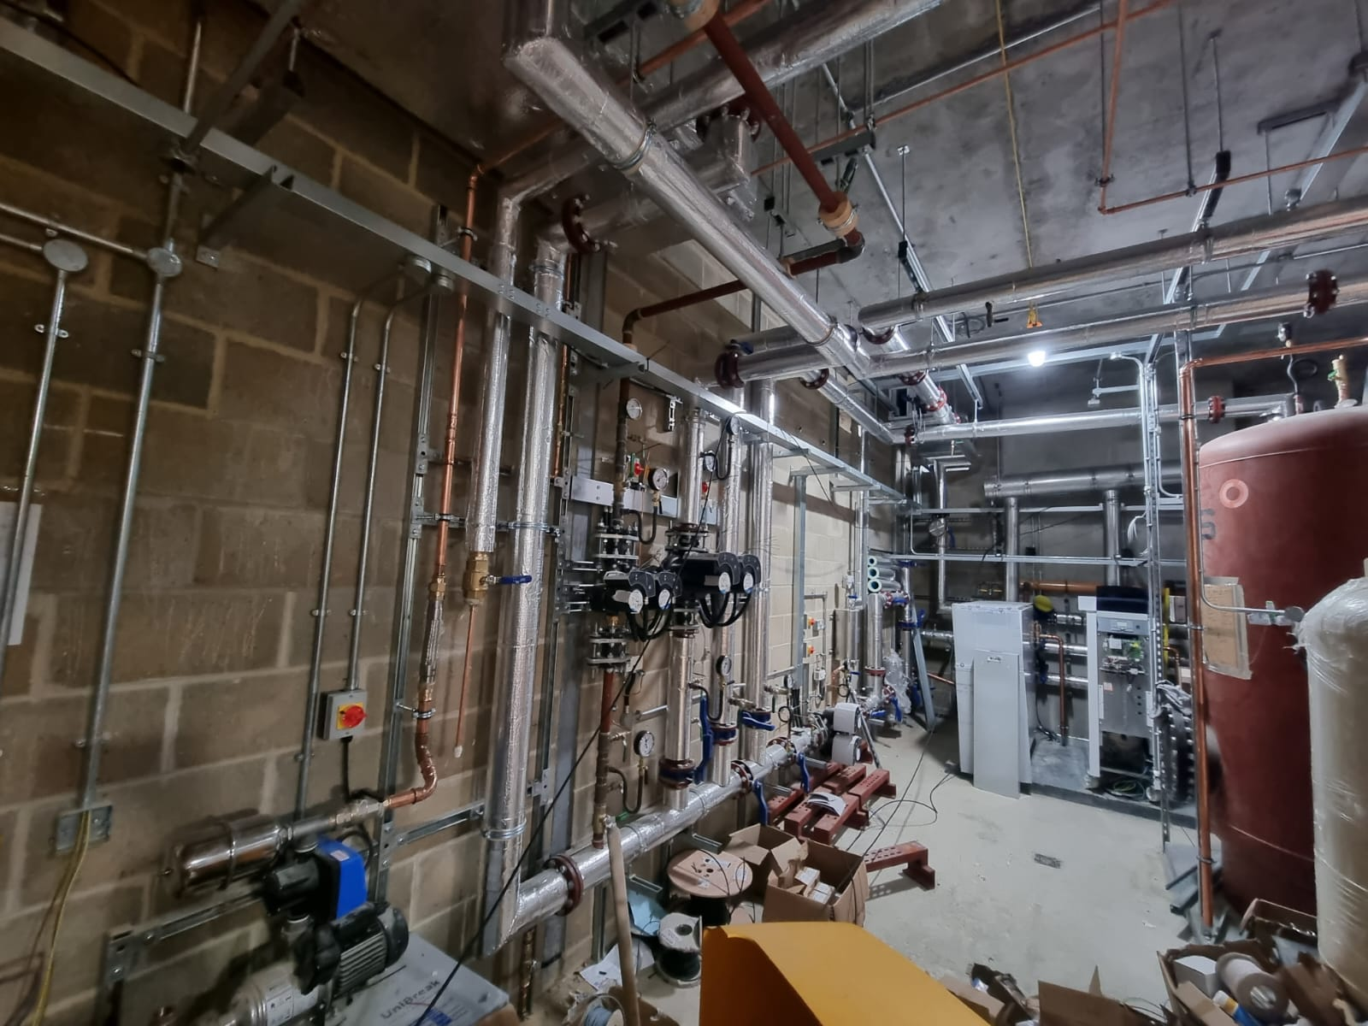
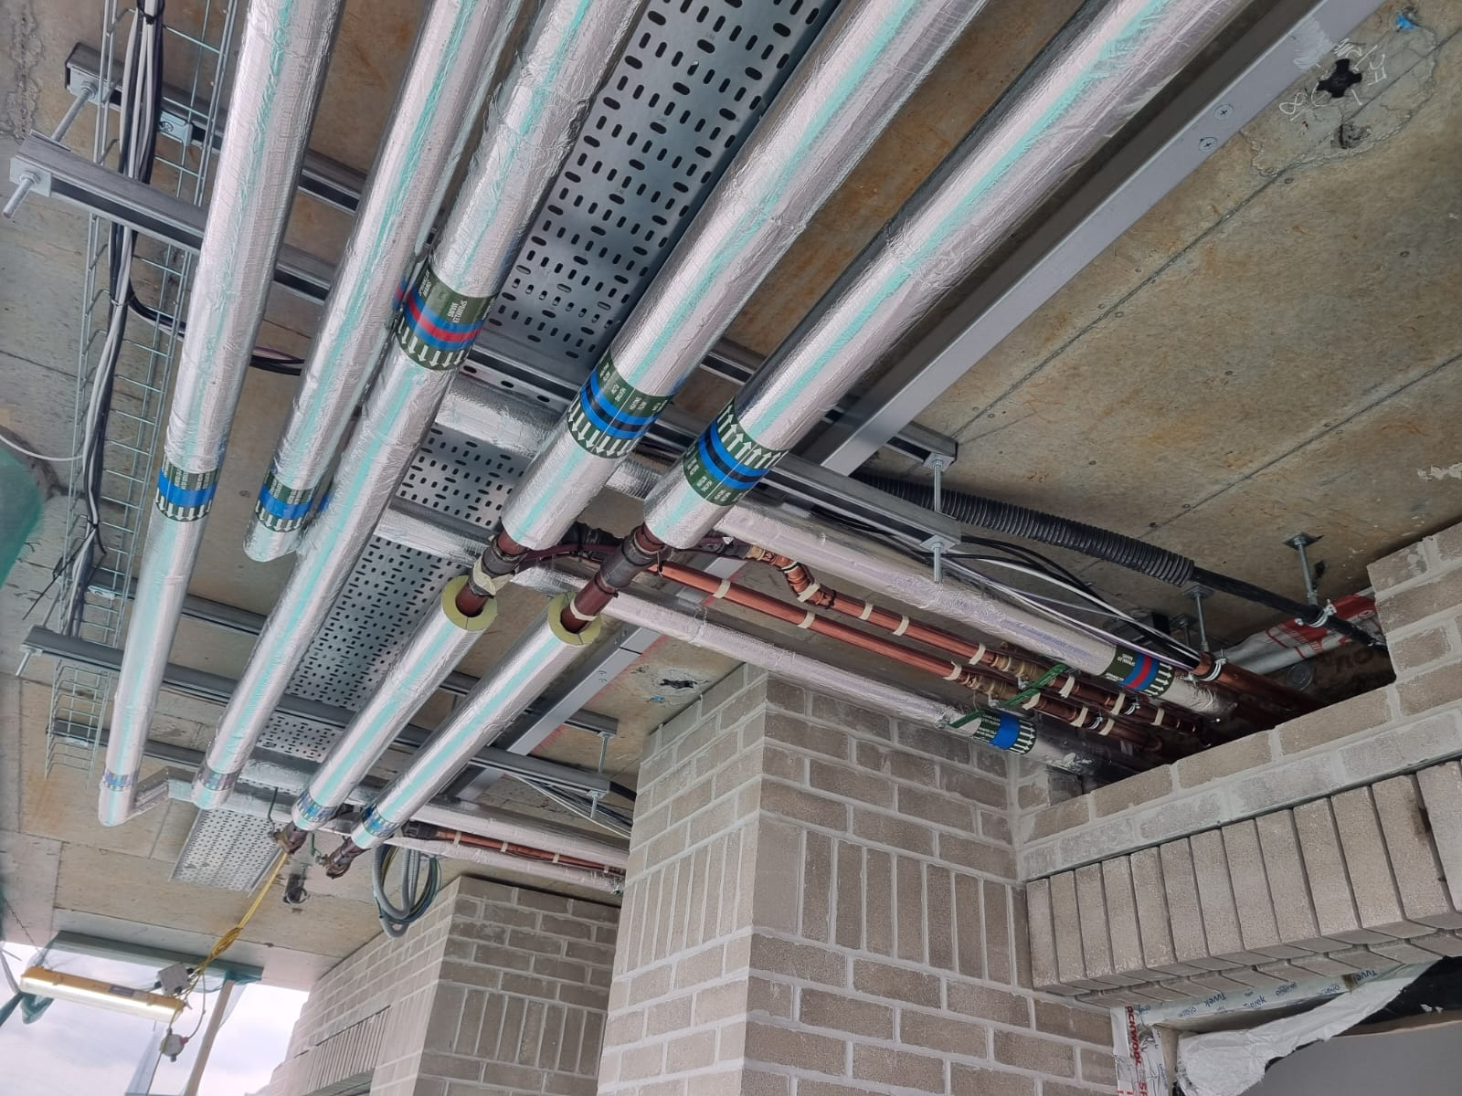
Residential Building: - Building services (Mechanical, Electrical, Plumbing & Heating)
Basement boiler room Typical service penetration into flats Heat interface unit cupboard

Slide 6
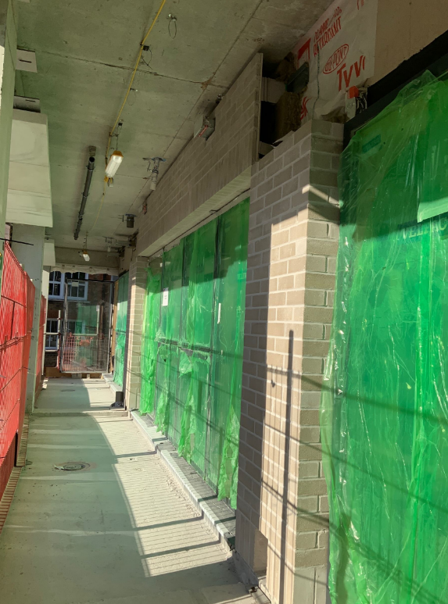
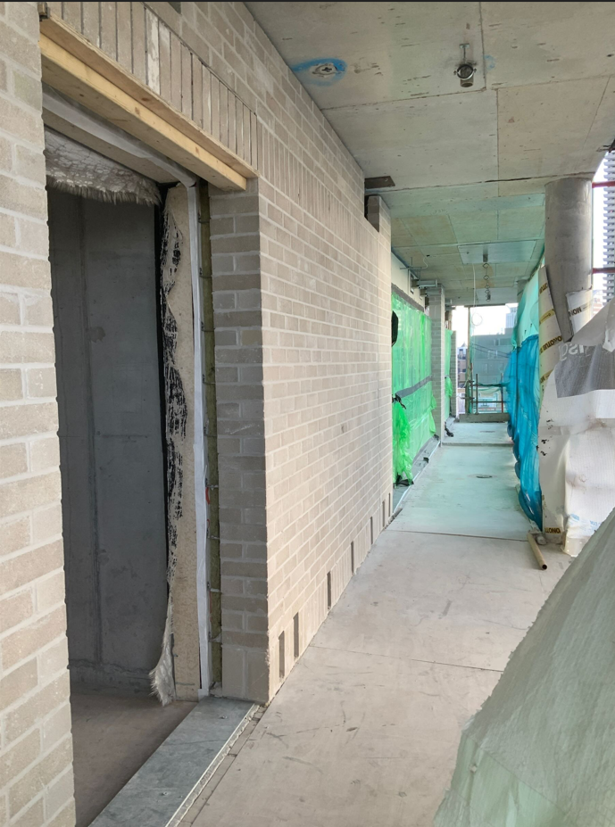
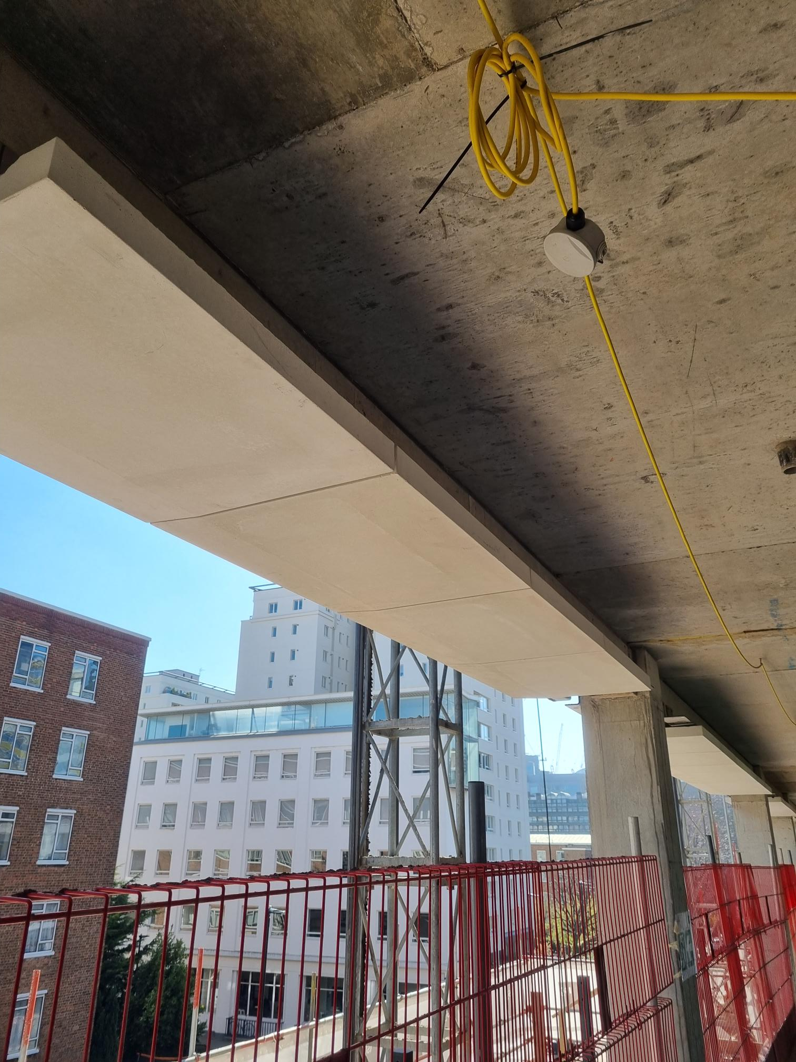
Residential Building: - Brickwork, Glass-Reinforced Concrete and Fablite
West elevation glass-reinforced concrete West elevation fablite and brickwork Brickwork to core and fablite

Slide 7
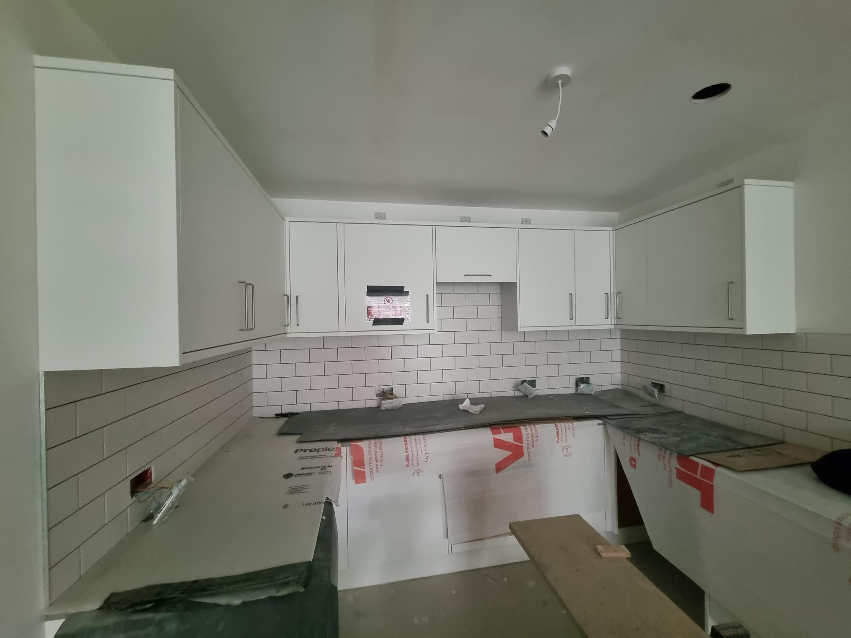
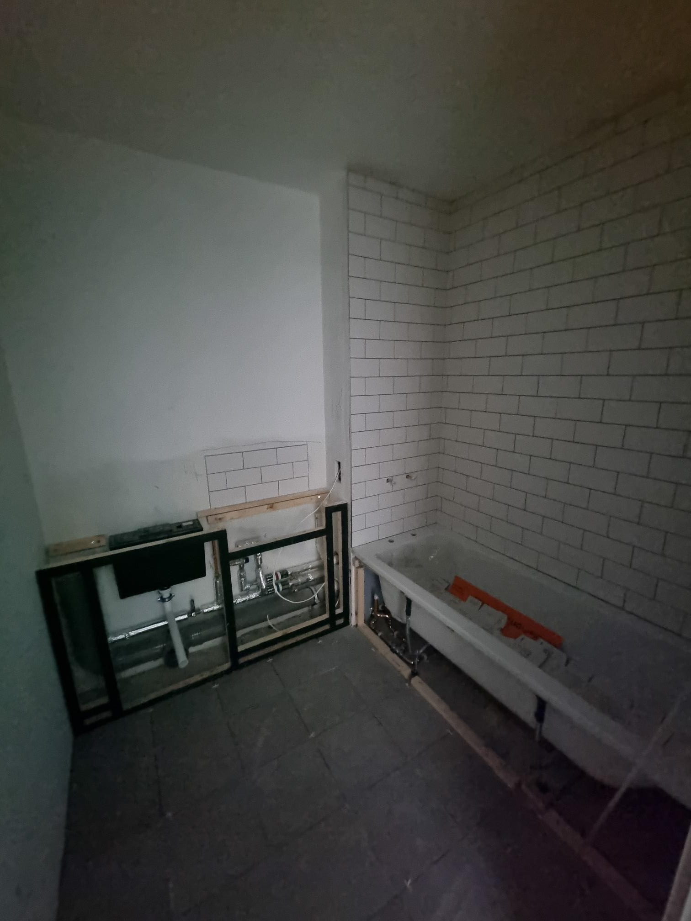
Residential Building: - Kitchens and bathrooms
Flat 4 Kitchen Flat 1 Bathroom

Slide 8
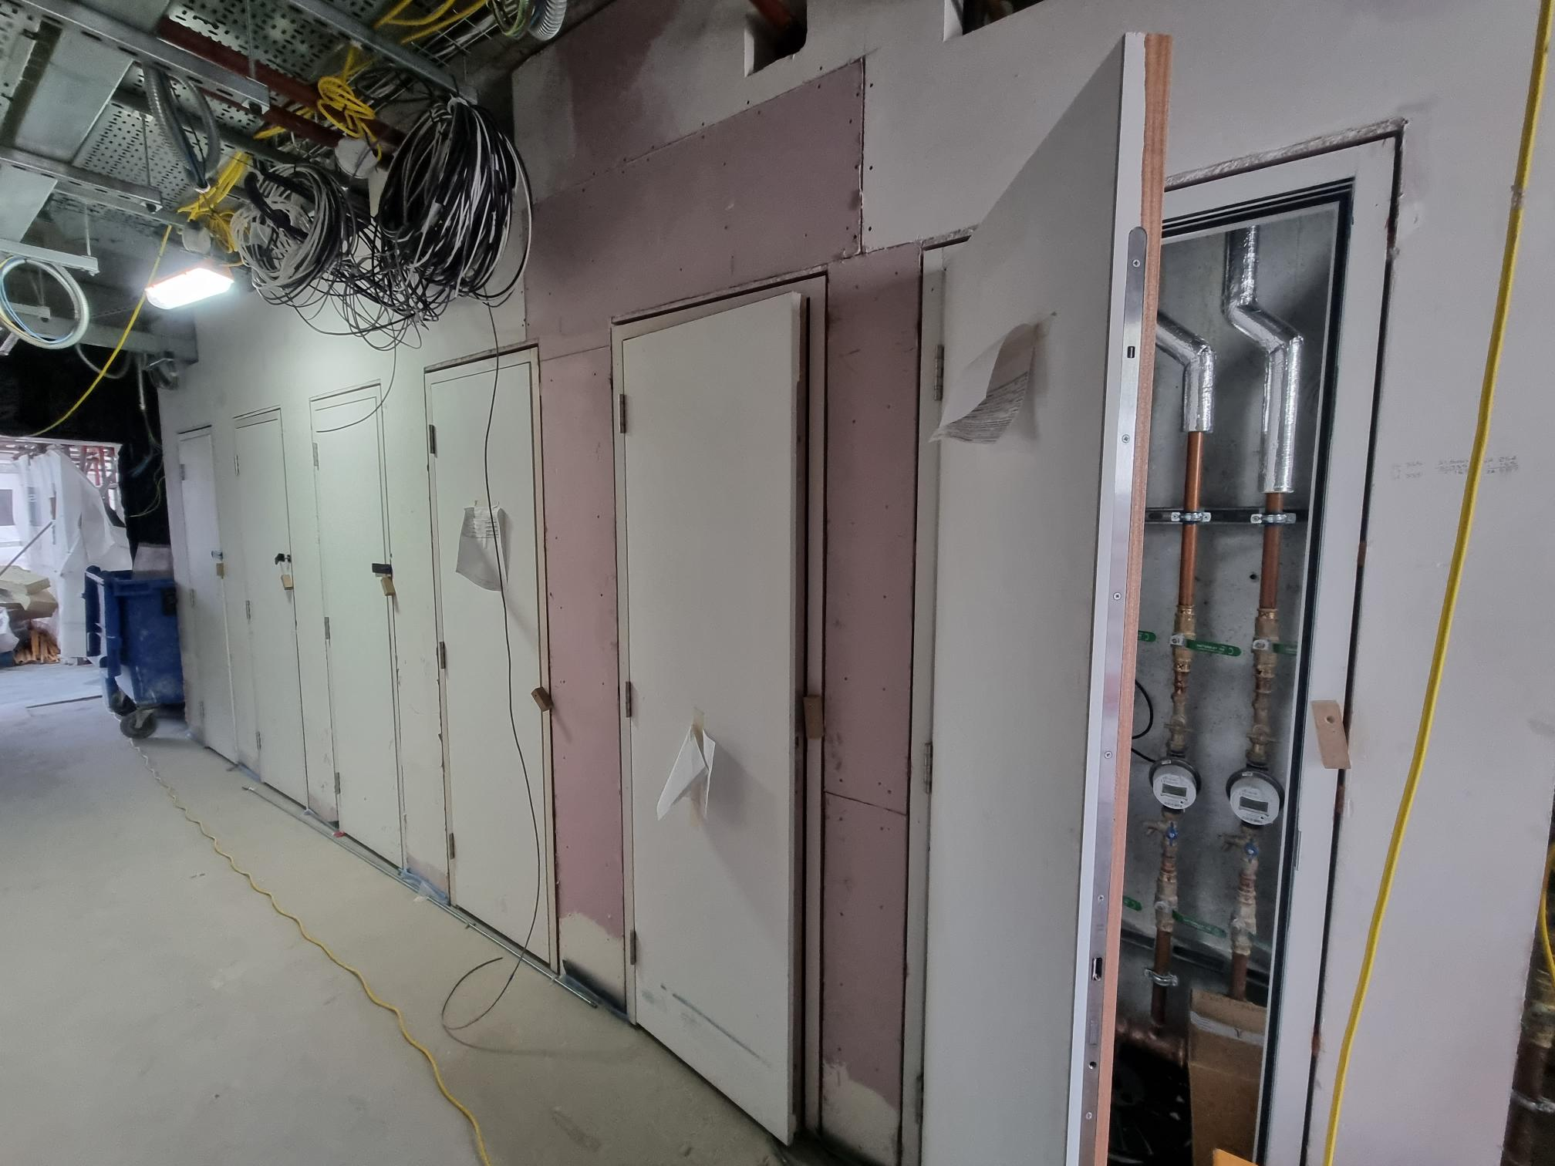
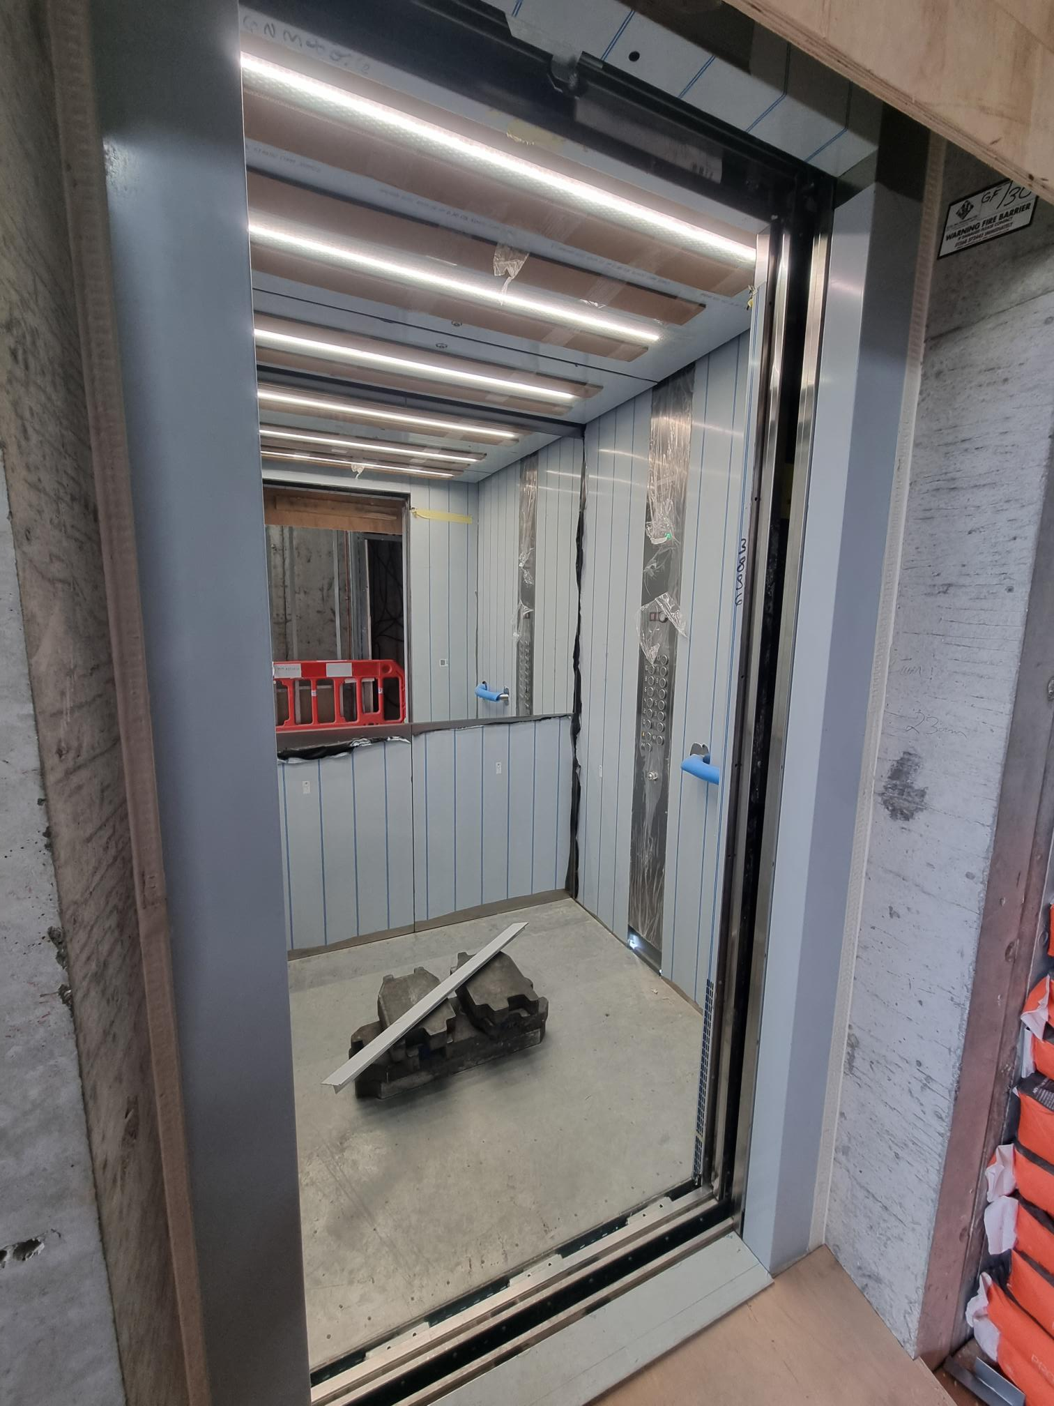
Residential Building: - Lift lobby
Internal lift progress Riser doors

Slide 9
Working Hours And COVID-19 Guidance
Working hours
Monday to Friday
8am - 6pm
Saturday
9am - 2pm
HSE guidelines and support
https://www.hse.gov.uk/coronavirus/working-safely/index.htm
Government guidelines
https://www.gov.uk/coronavirus

Slide 10
Project Timeline
Completion: September 2022
Key Milestones
Removal of hoist and mast climbers in June 2022
Removal of temporary substations in May 2022
Removal of site huts in June 2022
Commencement of external works in June 2022
School entrance operational from Golden Lane upon completion.

Slide 11
Q&A

